Slide 1

Azure Cosmos DB Workshop

Slide 2

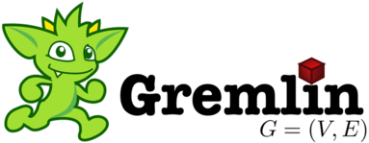




Azure Cosmos DB
A globally distributed, massively scalable, multi-model database service
Table API
MongoDB
Column-family
Document
Key-value
Graph
Elastic scale out
of storage & throughput
Guaranteed low latency at the 99th percentile
Five well-defined consistency models
Turnkey global distribution
Comprehensive SLAs
Notes:
Azure Cosmos DB offers the first globally distributed, multi-model database service for building planet scale apps. It’s been powering Microsoft’s internet-scale services for years, and now it’s ready to launch yours.
Only Azure Cosmos DB makes global distribution turn-key.
You can add Azure locations to your database anywhere across the world, at any time, with a single click. Cosmos DB will seamlessly replicate your data and make it highly available.
Cosmos DB allows you to scale throughput and storage elastically, and globally! You only pay for the throughput and storage you need – anywhere in the world, at any time.

Slide 3
Our Story

Slide 4



Azure Cosmos DB Evolution
Originally started to address the problems faced by large scale apps inside Microsoft
Built from the ground up for the cloud
Used extensively inside Microsoft
One of the fastest growing services on Azure
2010
2014
2015
2017
Project Florence
DocumentDB
Cosmos DB

Slide 5

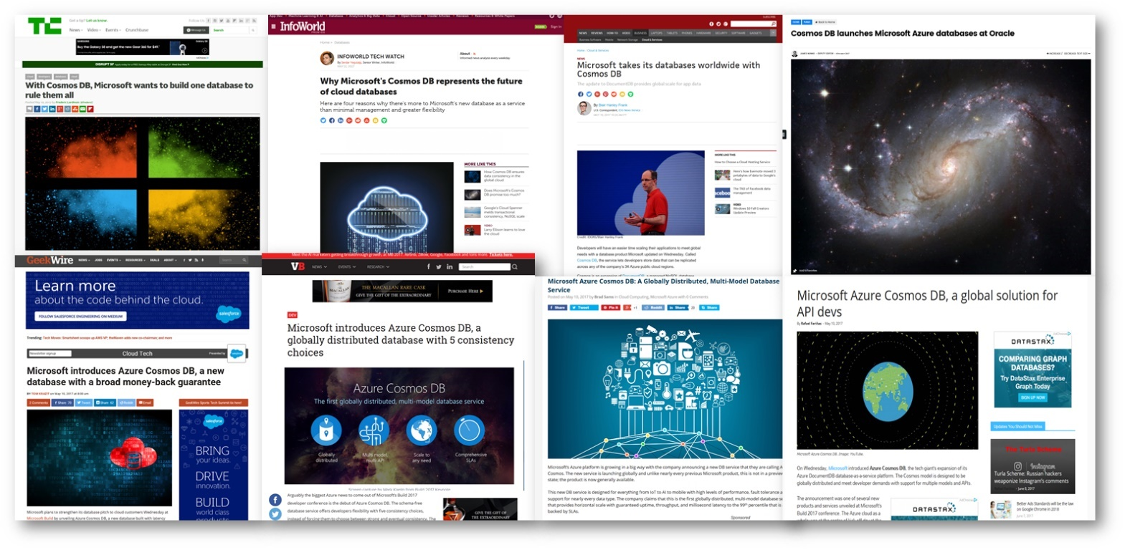
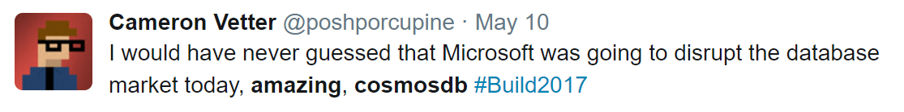
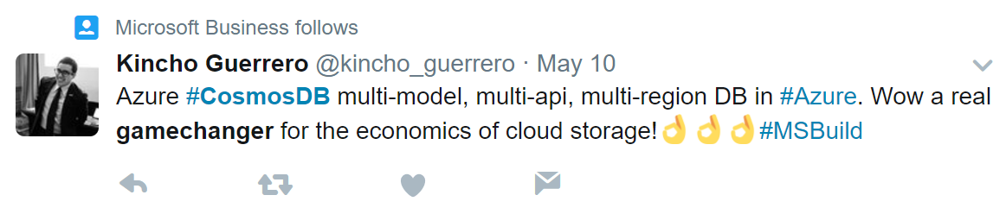
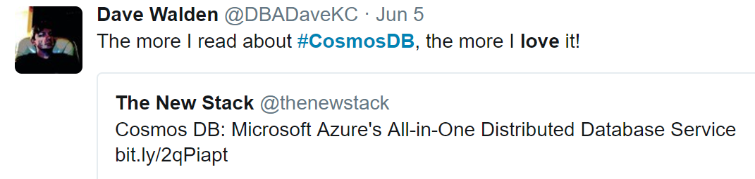

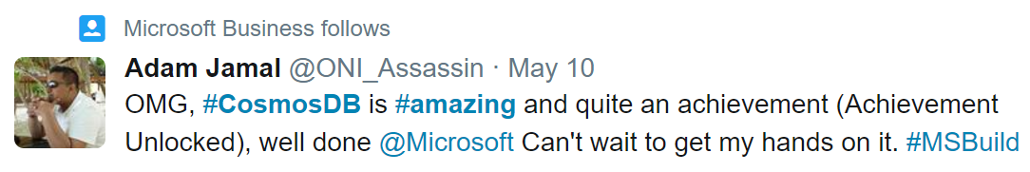

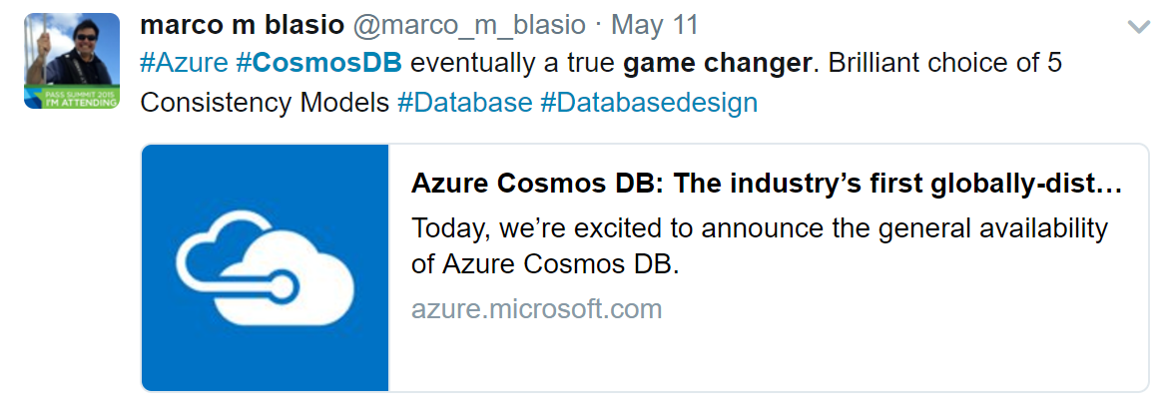

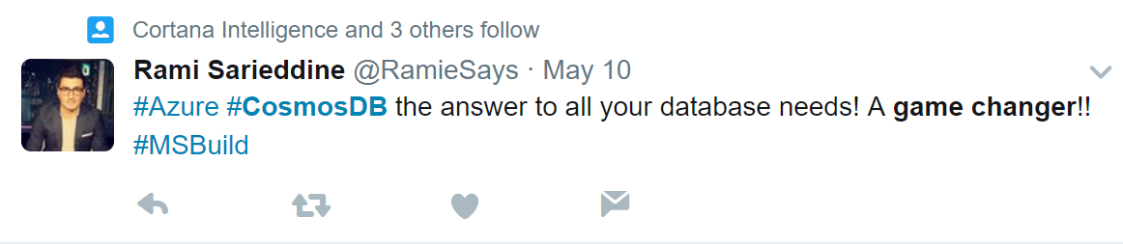
From validation to momentum
Overall
+27
32
Key Value
Wide Column
Document
Graph
3
+5
3
+1
5
+5
2
+2

Slide 6
What sets Azure Cosmos DB apart

Slide 7
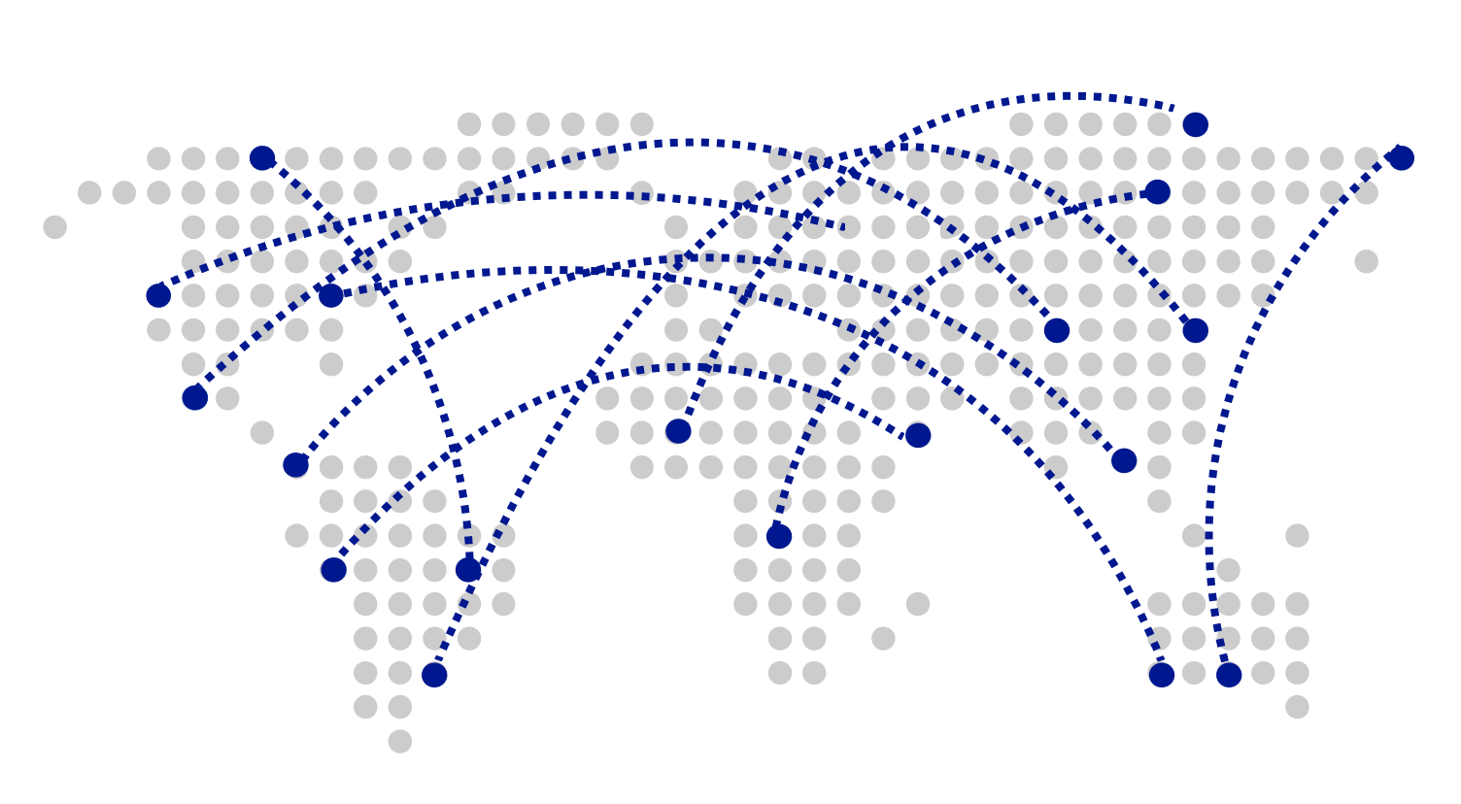
Turnkey Global Distribution
Worldwide presence as a Foundational Azure service
Automatic multi-region replication
Multi-homing APIs
Manual and automatic failovers
Designed for High Availability
Notes:
Cosmos DB is a Foundational (Ring 0) Azure service
Available in all Azure regions by default, including sovereign/government clouds
Transparent and automatic multi-region replication
Associate any number of regions with your database account, at any time
Policy based geo-fencing
Multi-homing APIs
All endpoints are logical, by default
Apps don’t need to be redeployed during regional failover
Apps can also access physical endpoints if needed
Support for both manual and automatic failover
Designed for high availability
Allows for dynamically setting priorities to regions
Simulate regional disasters via API
Test the end-to-end availability for the entire app (beyond just the database)

Slide 8

Guaranteed low latency at P99 (99th percentile)
Requests are served from local region
Single-digit millisecond latency worldwide
Write optimized, latch-free database engine designed for SSD
Synchronous automatic indexing at sustained ingestion rates
Reads
(1KB)
Indexed writes
(1KB)
P50
<2ms
<6ms
P99
<10ms
<15ms
Notes:
Unique design of the quorum based replication protocol
Globally distributed with reads and writes served from local region
Well defined consistency models designed to provide precise consistency guarantees
Unique design of database engine
Write optimized, latch-free database engine designed for SSDs and low latency access
Culmination of decades of database system research in marrying the best of NoSQL techniques for the write path with the Relational query optimized data structures concurrent btree on the read/query path
Benchmarked to have the lowest write and read amplifications.
Better performance and TCO compared to all popular log structured engines LevelDB, RocksDB, TokuDB, WiredTiger
Fully resource governed NO WRITE PAUSES
Synchronous and automatic indexing at sustained ingestion rates
No schema or index management needed
No schema versioning needed
No schema migration needed
All of this is highly relevant for rapidly evolving apps in a globally distributed setup
Cosmos DB guarantees low latency access by serving reads and writes from the local regions. This helps your applications to beat the speed of light or network latency across regions.
Nucleus of Cosmos DB is a write optimized, latch-free database engine which is designed for Solid State Drives. The core design point is low latency and performance and global scale.
Cosmos DB indexes all your data automatically, synchronously at sustained ingestion rates. There is no overhead of secondary indexes as with other databases. Most of us know the pain of managing indexes. Now imagine for a moment maintaining, managing, migrating indexes at global scale. It is almost impossible but with Azure Cosmos DB, you don’t have to. At P99 Cosmos DB guarantees <10ms latency for read access and <15ms for write access. Most applications will experience even lower latency of under <2ms for reads and <6ms for writes.
Several of our large scale cloud services at Microsoft uses Cosmos DB for low latency access. All the device telemetry from windows mobile devices is stored in a globally distributed database and with 100s of millions of devices out there, low latency was a key factor in deciding on the right data store.

Slide 9
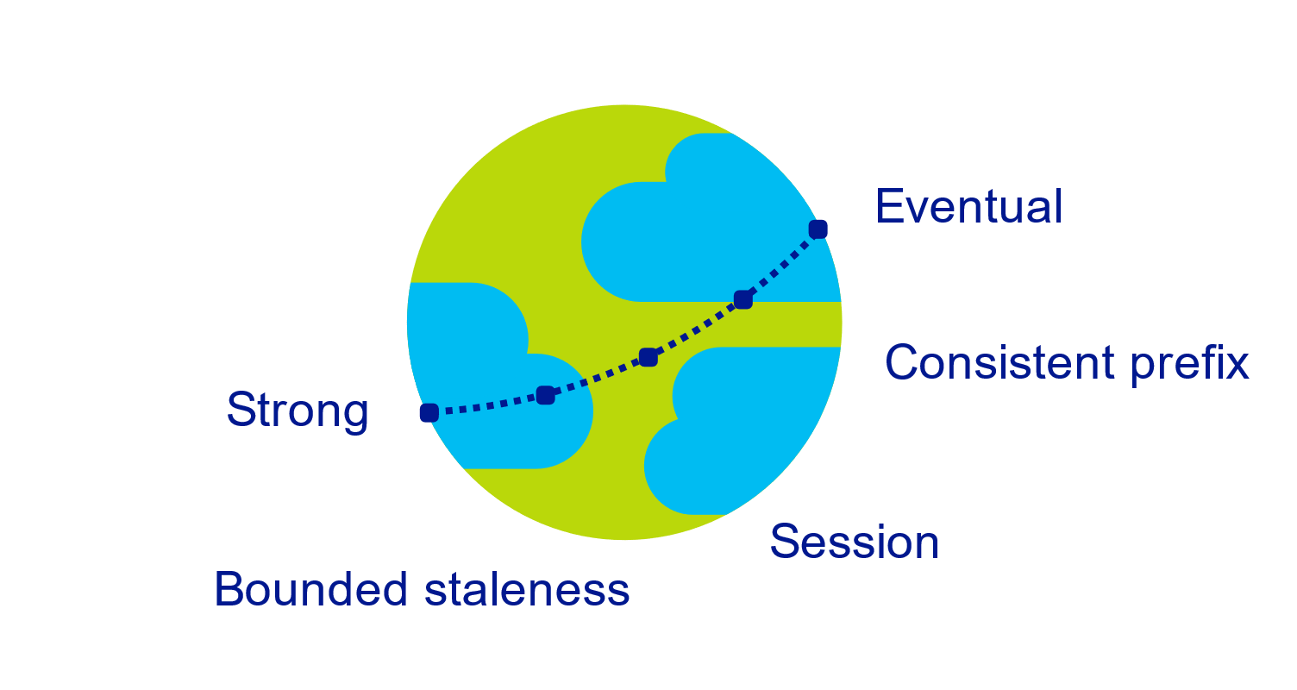
Multiple, well-defined consistency choices
Global distribution forces us to navigate the CAP theorem
Writing correct distributed applications is hard
Five well-defined consistency levels
Intuitive and practical with clear PACELC tradeoffs
Programmatically change at anytime
Can be overridden on a per-request basis
Notes:
Databases are divided into two categories
Provide extreme choices – strong vs. eventual consistency (e.g., DynamoDB)
Leave everything for developers to configure (e.g., Cassandra)
Read repair, Hinted handoff, quorum sizes, replication topologies etc
Developers have to make precise tradeoffs between
Consistency and availability (during failures)
Consistency and latency (during steady state)
Consistency and throughput (this is important for TCO reasons)

Slide 10
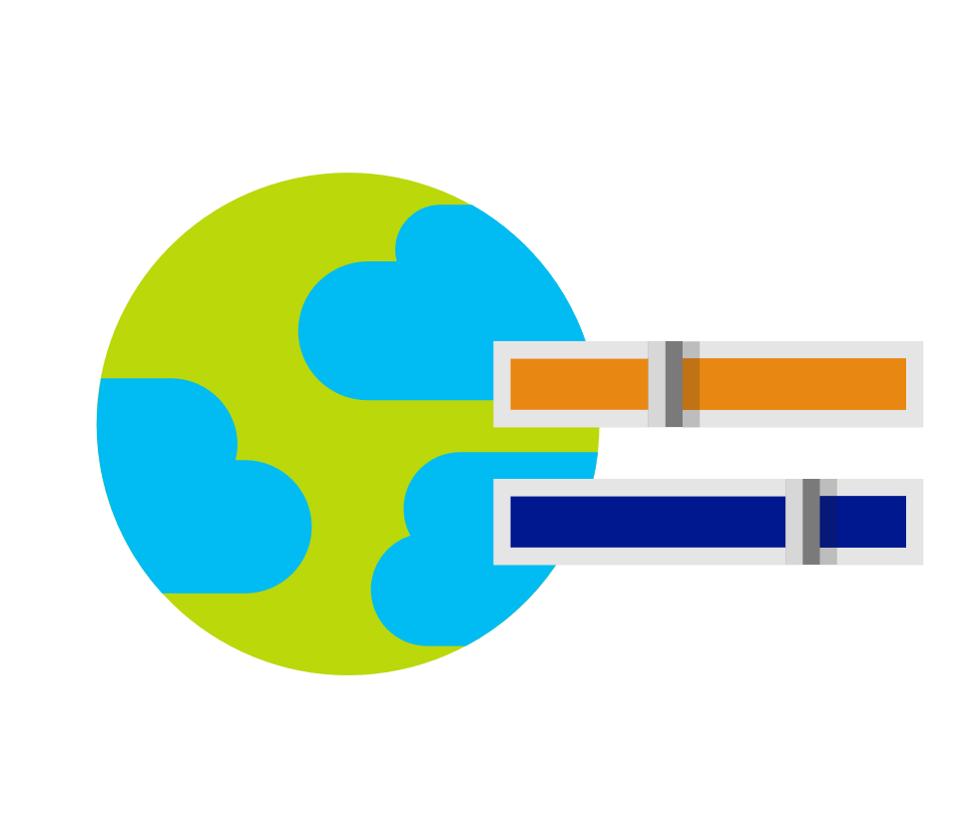
Elastically scalable storage and throughput
Single machine is never a bottle neck
Transparent server-side partition management
Elastically scale storage (GB to PB) and throughput (100 to 100M req/sec) across many machines and multiple regions
Automatic expiration via policy based TTL
Pay by the hour, change throughput at any time for only what you need
12000000
10000000
8000000
6000000
4000000
2000000
Black Friday
Provisioned request / sec
Nov 2016
Dec 2016
Time
Hourly throughput (request/sec)
Notes:
Single machine is never a bottleneck
A single table can scale from GB-PBs, across many machines, and regions
Transparent server side partition management and routing
Optionally evict old data using built-in support for TTL
Customers pay only for the throughput and storage they need
Elastically scale throughput from 10 to 100s of millions of requests/sec across multiple regions
Customers pay only for the throughput and storage they need
Customers pay by the hour for the provisioned throughput

Slide 11
Schema-agnostic, automatic indexing
At global scale, schema/index management is painful
Automatic and synchronous indexing
Hash, range, and geospatial
Works across every data model
Highly write-optimized database engine
Schema
Physical index
Notes:
At global scale, schema/index management is hard
Automatic and synchronous indexing of all ingested content - hash, range, geo-spatial, and columnar
No need to define schemas or secondary indices upfront
Resource governed, write optimized database engine with latch free and log structured techniques
Online and in-situ index transformations

Slide 12
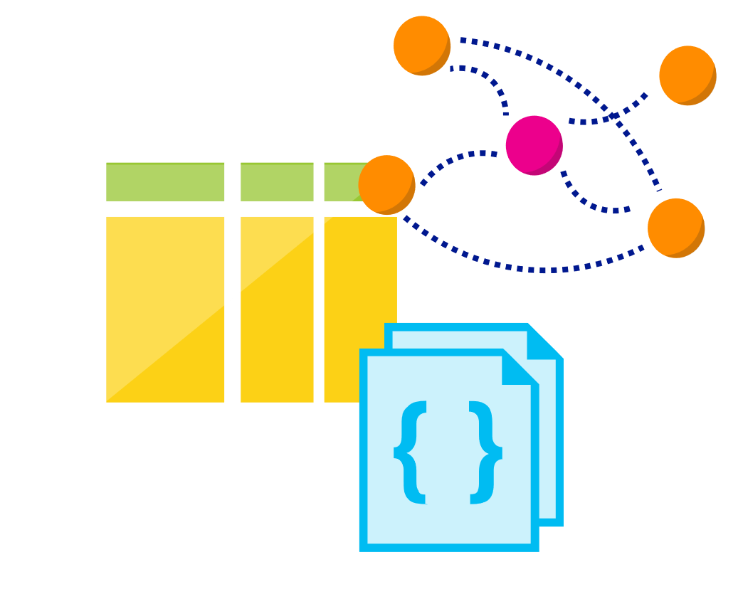
Multi-model, multi-API
Database engine operates on Atom-Record-Sequence type system
All data models can be efficiently translated to ARS
Multi-model: Key-value, Document, and Graph
Multi-API: SQL (DocumentDB), MongoDB, Table, and Gremlin
More data-models and APIs to be added
Notes:
Azure Cosmos DB natively supports multiple data models including documents, key-value, graph, and column-family. The core content-model of Cosmos DB’s database engine is based on atom-record-sequence (ARS). Atoms consist of a small set of primitive types like string, bool, and number. Records are structs composed of these types. Sequences are arrays consisting of atoms, records, or sequences.
The database engine can efficiently translate and project different data models onto the ARS-based data model. The core data model of Cosmos DB is natively accessible from dynamically typed programming languages and can be exposed as-is as JSON.
The service also supports popular database APIs for data access and querying. Cosmos DB’s database engine currently supports DocumentDB SQL, MongoDB, Azure Tables(preview), and Gremlin (preview). You can continue to build applications using popular OSS APIs and get all the benefits of a battle-tested and fully managed, globally distributed database service.

Slide 13
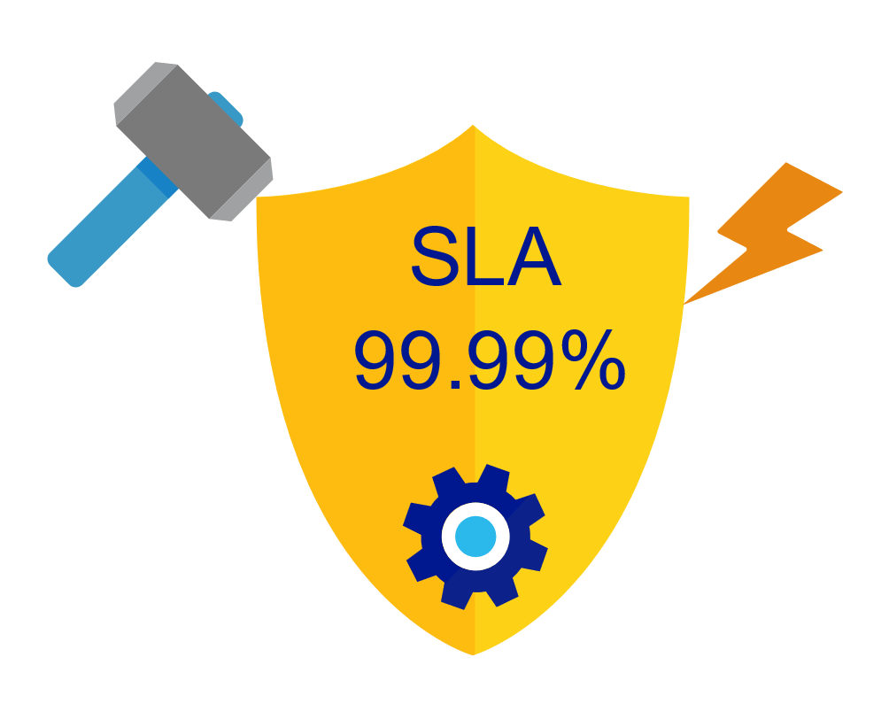
Industry-leading, enterprise-grade SLAs
99.99% availability – even with a single region
Made possible with highly-redundant storage architecture
Guaranteed durability – writes are majority quorum committed
First and only service to offer SLAs on:
Low-latency
Consistency
Throughput
Notes:
Globally distributed database needs to tackle
latency vs. consistency tradeoffs (in steady state)
availability vs. consistency tradeoff (during failures)
throughput vs. consistency tradeoffs during all times
throughput vs. latency tradeoffs during all times
Simply offering high availability SLAs are not sufficient!
Cosmos DB:
99.99% HA within a single region
99.99 SLA throughput, latency, consistency all at the 99th percentile

Slide 14

Security & Compliance
Always encrypted at rest and in motion
Fine grained “row level” authorization
Network security with IP firewall rules
Comprehensive Azure compliance certification:
ISO 27001
ISO 27018
EUMC
HIPAA
PCI
SOC1 and SOC2
Notes:
As a foundational Azure Service, Security and Compliance is an important aspect of Azure Cosmos DB. Several high value Microsoft services that have stringent compliance and security requirements are built on Azure Cosmos DB. All of the data is encrypted at rest and it is enabled by default. We made sure that we continue to provide the performance guarantees even with encryption enabled and this is transparent to your application.

Slide 15
Common Use Cases and Scenarios

Slide 16


Globally Distributed Apps
Business Needs:
High scalability to support massive user base
Low latency access across multiple geographies to build highly responsive applications
Automatic indexing over flexible schemas to support rich queries over user-defined content (e.g. custom form builder)
High availability across multiple data centers

Slide 17

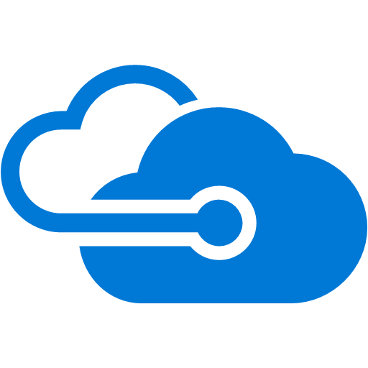

Content Management Systems
Azure region A
Azure Cosmos DB
(app + session state)
Azure region B
Azure Traffic Manager
Globally distributed
across regions
Azure region C

Slide 18

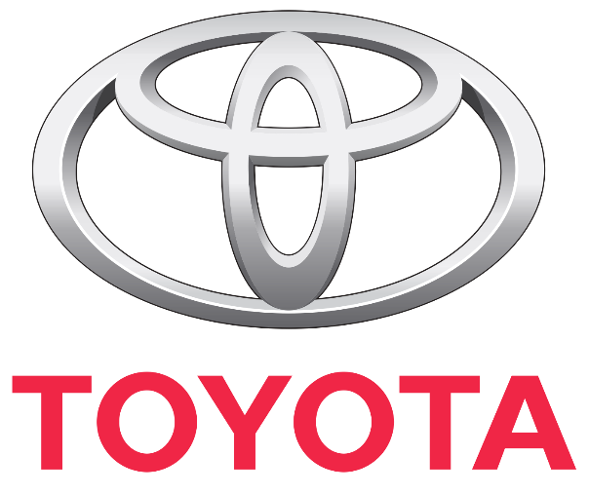



Internet of Things – Telemetry & Sensor Data
Business Needs:
High scalability to ingest large # of events coming from many devices
Low latency queries and changes feeds for responding quickly to anomalies
Schema-agnostic storage and automatic indexing to support dynamic data coming from many different generations of devices
High availability across multiple data centers

Slide 19







Internet of Things – Telemetry & Sensor Data
Azure Data Lake (Cold)
Apache Spark on
Azure HDInsight
Azure Cosmos DB (Hot)
(TTL = 30 days)
Apache Kafka on
Azure HDInsight
Apache Storm on
Azure HDInsight
PowerBI
Azure Web App

Slide 20

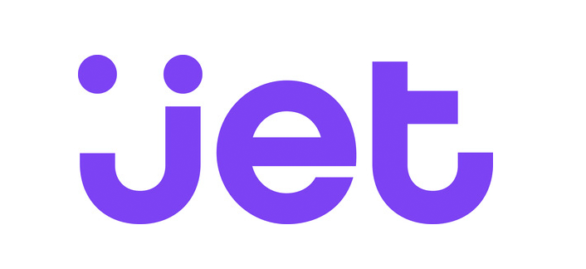



Retail – Product Catalog & Order Processing
Business Needs:
Elastic scale to handle seasonal traffic (e.g. Black Friday)
Low-latency access across multiple geographies to support a global user-base and latency sensitive workloads (e.g. real-time personalization)
Schema-agnostic storage and automatic indexing to handle diverse product catalogs, orders, and events
High availability across multiple data centers

Slide 21

Retail Product Catalogs
Azure Web App
(e-commerce app)
Azure Cosmos DB
(product catalog)
Azure Search (full-text index)
Azure Storage
(logs, static catalog content)
Azure Cosmos DB
(session state)

Slide 22




Retail Order Processing Pipelines
Azure Functions
(E-Commerce Checkout API)
Azure Cosmos DB (Order Event Store)
. . .
Azure Functions
(Microservice 1: Tax)
Azure Functions
(Microservice 2: Payment)
Azure Functions
(Microservice N: Fufillment)

Slide 23
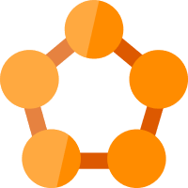



Real-time Recommendations
Online Recommendations Service (HOT path)
Azure Service Fabric
(Personalization Decision Engine)
Azure Cosmos DB
(distributed model store)
Shoppers
ASOS.com
(Product Details Page)
Azure Data Factory
(scheduled job to refresh persisted models)
Azure Event Hub
Azure Data Lake Storage
(offline raw data)
+
Apache Spark on Azure HDInsight
Offline Recommendations Engine (COLD path)

Slide 24




Multiplayer Gaming
Business Needs:
Elastic scale to handle bursty traffic on day
Low-latency queries to support responsive gameplay for a global user-base
Schema-agnostic storage and indexing allows teams to iterate quickly to fit a demanding ship schedule
Change-feeds to support leaderboards and social gameplay

Slide 25




Multiplayer Gaming
Azure CDN
Azure Storage
(game files)
Azure API Apps
(game backend)
Azure Cosmos DB
(game database)
Azure HDInsight (game analytics)
Azure Traffic Manager
Azure Functions
Azure Notification Hubs
(push notifications)

Slide 26



Customer 360 + Operational Analytics
Business Needs:
High scalability to handle large user base
Rich queries and automatic indexing over flexible schemas to consolidate data from a variety of sources
Built-in aggregates and efficient spark connector to analyze user behavior, drive insights, and build a single view of the customer.

Slide 27
Customer 360 + Social Analytics
1st-Party and 3rd-Party
Data Sources
Azure Cosmos DB
(Master Data)
Spark on
Azure HDInsight

Slide 28
Scale-out Computation
Spark SQL
Spark Streaming
GraphX (graph)
MLlib (machine learning)
Apache Spark on HDInsight
Scale-out Database
Spark Connector using DocumentDB API
Azure Cosmos DB

Slide 29

Messaging
Business Needs:
High scalability to ingest and store messages from a massive user base
Low latency access across multiple geographies to support global user-base
High availability across multiple data centers

Slide 30
Messaging
Week 0
Azure Cosmos DB
(message data – partitioned by userid)
Azure Search
(full-text index)
Azure Web App
(messaging app)

Slide 31
Messaging
Week 0
Azure Cosmos DB
(message data – partitioned by userid)
Azure Search
(full-text index)
Week 1
Azure Web App
(messaging app)
Azure Cosmos DB
(message data – partitioned by userid)
Azure Search
(full-text index)

Slide 32
Messaging
Week 0
Azure Cosmos DB
(message data – partitioned by userid)
Azure Search
(full-text index)
Week 1
Azure Web App
(messaging app)
Azure Cosmos DB
(message data – partitioned by userid)
Azure Search
(full-text index)
Week 2
Azure Cosmos DB
(message data – partitioned by userid)
Azure Search
(full-text index)

Slide 33

Let’s zoom in Azure Cosmos DB

Slide 34
Resource Model

Slide 35
Account
Database
Container
Item
Notes:
A tenant of the Cosmos DB service starts by provisioning a database account. A database account manages one or more databases. A Cosmos DB database manages users, permissions and containers. A Cosmos DB resource container is a schema-agnostic container of arbitrary user-generated JSON items and JavaScript based stored procedures, triggers and user-defined-functions (UDFs). Entities under the tenant’s database account – databases, users, permissions, containers etc. are referred to as resources.
Each resource is uniquely identified by a stable and logical URI and represented as a JSON document. The overall resource model of an application using Cosmos DB is a hierarchical overlay of the resources rooted under the database account, and can be navigated using hyperlinks. Except for the item resource, which is used to represent arbitrary user defined JSON content, all other resources have a system-defined schema.
Container and item resources are further projected as reified resource types for a specific type of API interface. For example, while using document-oriented APIs, container and item resources are projected as collection (container) and document (item) resources, respectively; likewise, for graph-oriented API access, the underlying container and item resources are projected as graph (container), node (item) and edge (item) resources respectively; while accessing using a key-value API table (container) and item/row (item) are projected.

Slide 36


********.azure.com
Account
Database
IGeAvVUp …
Container
Item
Notes:
A tenant of the Cosmos DB service starts by provisioning a database account. A database account manages one or more databases. A Cosmos DB database manages users, permissions and containers. A Cosmos DB resource container is a schema-agnostic container of arbitrary user-generated JSON items and JavaScript based stored procedures, triggers and user-defined-functions (UDFs). Entities under the tenant’s database account – databases, users, permissions, containers etc. are referred to as resources.
Each resource is uniquely identified by a stable and logical URI and represented as a JSON document. The overall resource model of an application using Cosmos DB is a hierarchical overlay of the resources rooted under the database account, and can be navigated using hyperlinks. Except for the item resource, which is used to represent arbitrary user defined JSON content, all other resources have a system-defined schema.
Container and item resources are further projected as reified resource types for a specific type of API interface. For example, while using document-oriented APIs, container and item resources are projected as collection (container) and document (item) resources, respectively; likewise, for graph-oriented API access, the underlying container and item resources are projected as graph (container), node (item) and edge (item) resources respectively; while accessing using a key-value API table (container) and item/row (item) are projected.

Slide 37
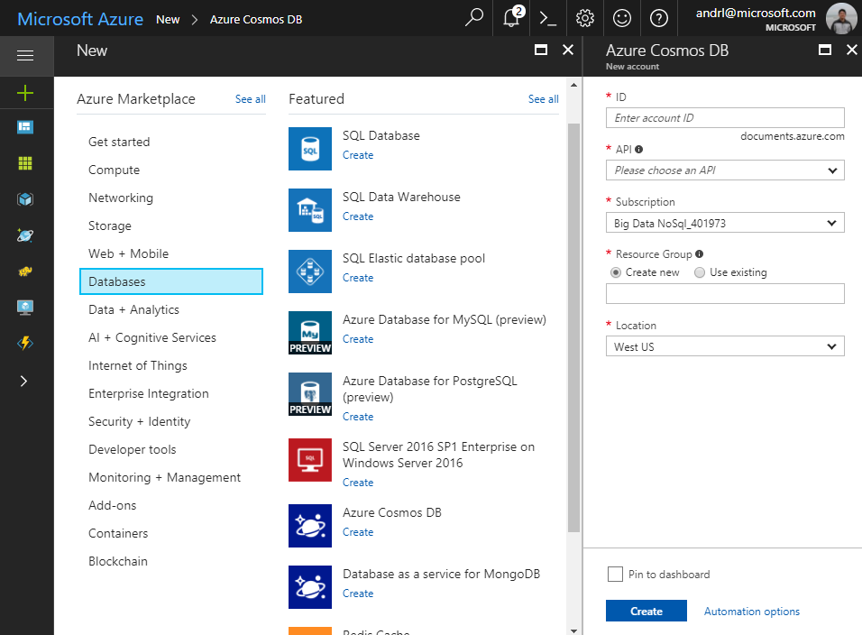
Account
Database
Container
Item
Notes:
A tenant of the Cosmos DB service starts by provisioning a database account. A database account manages one or more databases. A Cosmos DB database manages users, permissions and containers. A Cosmos DB resource container is a schema-agnostic container of arbitrary user-generated JSON items and JavaScript based stored procedures, triggers and user-defined-functions (UDFs). Entities under the tenant’s database account – databases, users, permissions, containers etc. are referred to as resources.
Each resource is uniquely identified by a stable and logical URI and represented as a JSON document. The overall resource model of an application using Cosmos DB is a hierarchical overlay of the resources rooted under the database account, and can be navigated using hyperlinks. Except for the item resource, which is used to represent arbitrary user defined JSON content, all other resources have a system-defined schema.
Container and item resources are further projected as reified resource types for a specific type of API interface. For example, while using document-oriented APIs, container and item resources are projected as collection (container) and document (item) resources, respectively; likewise, for graph-oriented API access, the underlying container and item resources are projected as graph (container), node (item) and edge (item) resources respectively; while accessing using a key-value API table (container) and item/row (item) are projected.

Slide 38
Account
Database
Container
Item
Notes:
A tenant of the Cosmos DB service starts by provisioning a database account. A database account manages one or more databases. A Cosmos DB database manages users, permissions and containers. A Cosmos DB resource container is a schema-agnostic container of arbitrary user-generated JSON items and JavaScript based stored procedures, triggers and user-defined-functions (UDFs). Entities under the tenant’s database account – databases, users, permissions, containers etc. are referred to as resources.
Each resource is uniquely identified by a stable and logical URI and represented as a JSON document. The overall resource model of an application using Cosmos DB is a hierarchical overlay of the resources rooted under the database account, and can be navigated using hyperlinks. Except for the item resource, which is used to represent arbitrary user defined JSON content, all other resources have a system-defined schema.
Container and item resources are further projected as reified resource types for a specific type of API interface. For example, while using document-oriented APIs, container and item resources are projected as collection (container) and document (item) resources, respectively; likewise, for graph-oriented API access, the underlying container and item resources are projected as graph (container), node (item) and edge (item) resources respectively; while accessing using a key-value API table (container) and item/row (item) are projected.

Slide 39
Account
Database
Container
Item
Notes:
A tenant of the Cosmos DB service starts by provisioning a database account. A database account manages one or more databases. A Cosmos DB database manages users, permissions and containers. A Cosmos DB resource container is a schema-agnostic container of arbitrary user-generated JSON items and JavaScript based stored procedures, triggers and user-defined-functions (UDFs). Entities under the tenant’s database account – databases, users, permissions, containers etc. are referred to as resources.
Each resource is uniquely identified by a stable and logical URI and represented as a JSON document. The overall resource model of an application using Cosmos DB is a hierarchical overlay of the resources rooted under the database account, and can be navigated using hyperlinks. Except for the item resource, which is used to represent arbitrary user defined JSON content, all other resources have a system-defined schema.
Container and item resources are further projected as reified resource types for a specific type of API interface. For example, while using document-oriented APIs, container and item resources are projected as collection (container) and document (item) resources, respectively; likewise, for graph-oriented API access, the underlying container and item resources are projected as graph (container), node (item) and edge (item) resources respectively; while accessing using a key-value API table (container) and item/row (item) are projected.

Slide 40
Account
Database
Container
Item
Notes:
A tenant of the Cosmos DB service starts by provisioning a database account. A database account manages one or more databases. A Cosmos DB database manages users, permissions and containers. A Cosmos DB resource container is a schema-agnostic container of arbitrary user-generated JSON items and JavaScript based stored procedures, triggers and user-defined-functions (UDFs). Entities under the tenant’s database account – databases, users, permissions, containers etc. are referred to as resources.
Each resource is uniquely identified by a stable and logical URI and represented as a JSON document. The overall resource model of an application using Cosmos DB is a hierarchical overlay of the resources rooted under the database account, and can be navigated using hyperlinks. Except for the item resource, which is used to represent arbitrary user defined JSON content, all other resources have a system-defined schema.
Container and item resources are further projected as reified resource types for a specific type of API interface. For example, while using document-oriented APIs, container and item resources are projected as collection (container) and document (item) resources, respectively; likewise, for graph-oriented API access, the underlying container and item resources are projected as graph (container), node (item) and edge (item) resources respectively; while accessing using a key-value API table (container) and item/row (item) are projected.

Slide 41
Account
Database
Container
Item
Notes:
A tenant of the Cosmos DB service starts by provisioning a database account. A database account manages one or more databases. A Cosmos DB database manages users, permissions and containers. A Cosmos DB resource container is a schema-agnostic container of arbitrary user-generated JSON items and JavaScript based stored procedures, triggers and user-defined-functions (UDFs). Entities under the tenant’s database account – databases, users, permissions, containers etc. are referred to as resources.
Each resource is uniquely identified by a stable and logical URI and represented as a JSON document. The overall resource model of an application using Cosmos DB is a hierarchical overlay of the resources rooted under the database account, and can be navigated using hyperlinks. Except for the item resource, which is used to represent arbitrary user defined JSON content, all other resources have a system-defined schema.
Container and item resources are further projected as reified resource types for a specific type of API interface. For example, while using document-oriented APIs, container and item resources are projected as collection (container) and document (item) resources, respectively; likewise, for graph-oriented API access, the underlying container and item resources are projected as graph (container), node (item) and edge (item) resources respectively; while accessing using a key-value API table (container) and item/row (item) are projected.

Slide 42
Account
Database
Container
Item
Notes:
A tenant of the Cosmos DB service starts by provisioning a database account. A database account manages one or more databases. A Cosmos DB database manages users, permissions and containers. A Cosmos DB resource container is a schema-agnostic container of arbitrary user-generated JSON items and JavaScript based stored procedures, triggers and user-defined-functions (UDFs). Entities under the tenant’s database account – databases, users, permissions, containers etc. are referred to as resources.
Each resource is uniquely identified by a stable and logical URI and represented as a JSON document. The overall resource model of an application using Cosmos DB is a hierarchical overlay of the resources rooted under the database account, and can be navigated using hyperlinks. Except for the item resource, which is used to represent arbitrary user defined JSON content, all other resources have a system-defined schema.
Container and item resources are further projected as reified resource types for a specific type of API interface. For example, while using document-oriented APIs, container and item resources are projected as collection (container) and document (item) resources, respectively; likewise, for graph-oriented API access, the underlying container and item resources are projected as graph (container), node (item) and edge (item) resources respectively; while accessing using a key-value API table (container) and item/row (item) are projected.

Slide 43
Account
Database
Container
Item
Notes:
A tenant of the Cosmos DB service starts by provisioning a database account. A database account manages one or more databases. A Cosmos DB database manages users, permissions and containers. A Cosmos DB resource container is a schema-agnostic container of arbitrary user-generated JSON items and JavaScript based stored procedures, triggers and user-defined-functions (UDFs). Entities under the tenant’s database account – databases, users, permissions, containers etc. are referred to as resources.
Each resource is uniquely identified by a stable and logical URI and represented as a JSON document. The overall resource model of an application using Cosmos DB is a hierarchical overlay of the resources rooted under the database account, and can be navigated using hyperlinks. Except for the item resource, which is used to represent arbitrary user defined JSON content, all other resources have a system-defined schema.
Container and item resources are further projected as reified resource types for a specific type of API interface. For example, while using document-oriented APIs, container and item resources are projected as collection (container) and document (item) resources, respectively; likewise, for graph-oriented API access, the underlying container and item resources are projected as graph (container), node (item) and edge (item) resources respectively; while accessing using a key-value API table (container) and item/row (item) are projected.

Slide 44
Account
Database
Container
Item
Notes:
A tenant of the Cosmos DB service starts by provisioning a database account. A database account manages one or more databases. A Cosmos DB database manages users, permissions and containers. A Cosmos DB resource container is a schema-agnostic container of arbitrary user-generated JSON items and JavaScript based stored procedures, triggers and user-defined-functions (UDFs). Entities under the tenant’s database account – databases, users, permissions, containers etc. are referred to as resources.
Each resource is uniquely identified by a stable and logical URI and represented as a JSON document. The overall resource model of an application using Cosmos DB is a hierarchical overlay of the resources rooted under the database account, and can be navigated using hyperlinks. Except for the item resource, which is used to represent arbitrary user defined JSON content, all other resources have a system-defined schema.
Container and item resources are further projected as reified resource types for a specific type of API interface. For example, while using document-oriented APIs, container and item resources are projected as collection (container) and document (item) resources, respectively; likewise, for graph-oriented API access, the underlying container and item resources are projected as graph (container), node (item) and edge (item) resources respectively; while accessing using a key-value API table (container) and item/row (item) are projected.

Slide 45
Account
Database
Container
Item
Notes:
A tenant of the Cosmos DB service starts by provisioning a database account. A database account manages one or more databases. A Cosmos DB database manages users, permissions and containers. A Cosmos DB resource container is a schema-agnostic container of arbitrary user-generated JSON items and JavaScript based stored procedures, triggers and user-defined-functions (UDFs). Entities under the tenant’s database account – databases, users, permissions, containers etc. are referred to as resources.
Each resource is uniquely identified by a stable and logical URI and represented as a JSON document. The overall resource model of an application using Cosmos DB is a hierarchical overlay of the resources rooted under the database account, and can be navigated using hyperlinks. Except for the item resource, which is used to represent arbitrary user defined JSON content, all other resources have a system-defined schema.
Container and item resources are further projected as reified resource types for a specific type of API interface. For example, while using document-oriented APIs, container and item resources are projected as collection (container) and document (item) resources, respectively; likewise, for graph-oriented API access, the underlying container and item resources are projected as graph (container), node (item) and edge (item) resources respectively; while accessing using a key-value API table (container) and item/row (item) are projected.

Slide 46
Account
Database
Container
Item
Notes:
A tenant of the Cosmos DB service starts by provisioning a database account. A database account manages one or more databases. A Cosmos DB database manages users, permissions and containers. A Cosmos DB resource container is a schema-agnostic container of arbitrary user-generated JSON items and JavaScript based stored procedures, triggers and user-defined-functions (UDFs). Entities under the tenant’s database account – databases, users, permissions, containers etc. are referred to as resources.
Each resource is uniquely identified by a stable and logical URI and represented as a JSON document. The overall resource model of an application using Cosmos DB is a hierarchical overlay of the resources rooted under the database account, and can be navigated using hyperlinks. Except for the item resource, which is used to represent arbitrary user defined JSON content, all other resources have a system-defined schema.
Container and item resources are further projected as reified resource types for a specific type of API interface. For example, while using document-oriented APIs, container and item resources are projected as collection (container) and document (item) resources, respectively; likewise, for graph-oriented API access, the underlying container and item resources are projected as graph (container), node (item) and edge (item) resources respectively; while accessing using a key-value API table (container) and item/row (item) are projected.

Slide 47
Account
Database
Container
User
Item
Permission
Notes:
A tenant of the Cosmos DB service starts by provisioning a database account. A database account manages one or more databases. A Cosmos DB database manages users, permissions and containers. A Cosmos DB resource container is a schema-agnostic container of arbitrary user-generated JSON items and JavaScript based stored procedures, triggers and user-defined-functions (UDFs). Entities under the tenant’s database account – databases, users, permissions, containers etc. are referred to as resources.
Each resource is uniquely identified by a stable and logical URI and represented as a JSON document. The overall resource model of an application using Cosmos DB is a hierarchical overlay of the resources rooted under the database account, and can be navigated using hyperlinks. Except for the item resource, which is used to represent arbitrary user defined JSON content, all other resources have a system-defined schema.
Container and item resources are further projected as reified resource types for a specific type of API interface. For example, while using document-oriented APIs, container and item resources are projected as collection (container) and document (item) resources, respectively; likewise, for graph-oriented API access, the underlying container and item resources are projected as graph (container), node (item) and edge (item) resources respectively; while accessing using a key-value API table (container) and item/row (item) are projected.

Slide 48
Account
Database
Container
=
Collection
Graph
Table
Item
Notes:
A tenant of the Cosmos DB service starts by provisioning a database account. A database account manages one or more databases. A Cosmos DB database manages users, permissions and containers. A Cosmos DB resource container is a schema-agnostic container of arbitrary user-generated JSON items and JavaScript based stored procedures, triggers and user-defined-functions (UDFs). Entities under the tenant’s database account – databases, users, permissions, containers etc. are referred to as resources.
Each resource is uniquely identified by a stable and logical URI and represented as a JSON document. The overall resource model of an application using Cosmos DB is a hierarchical overlay of the resources rooted under the database account, and can be navigated using hyperlinks. Except for the item resource, which is used to represent arbitrary user defined JSON content, all other resources have a system-defined schema.
Container and item resources are further projected as reified resource types for a specific type of API interface. For example, while using document-oriented APIs, container and item resources are projected as collection (container) and document (item) resources, respectively; likewise, for graph-oriented API access, the underlying container and item resources are projected as graph (container), node (item) and edge (item) resources respectively; while accessing using a key-value API table (container) and item/row (item) are projected.

Slide 49
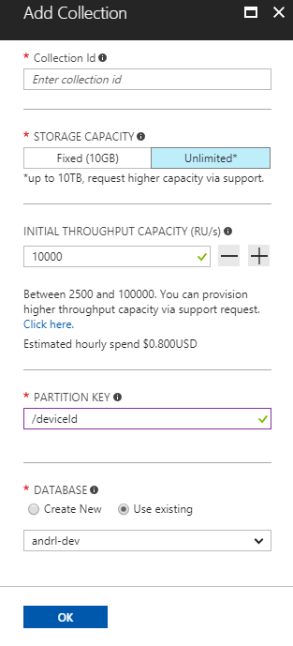
Account
Database
Container
Item
Notes:
A tenant of the Cosmos DB service starts by provisioning a database account. A database account manages one or more databases. A Cosmos DB database manages users, permissions and containers. A Cosmos DB resource container is a schema-agnostic container of arbitrary user-generated JSON items and JavaScript based stored procedures, triggers and user-defined-functions (UDFs). Entities under the tenant’s database account – databases, users, permissions, containers etc. are referred to as resources.
Each resource is uniquely identified by a stable and logical URI and represented as a JSON document. The overall resource model of an application using Cosmos DB is a hierarchical overlay of the resources rooted under the database account, and can be navigated using hyperlinks. Except for the item resource, which is used to represent arbitrary user defined JSON content, all other resources have a system-defined schema.
Container and item resources are further projected as reified resource types for a specific type of API interface. For example, while using document-oriented APIs, container and item resources are projected as collection (container) and document (item) resources, respectively; likewise, for graph-oriented API access, the underlying container and item resources are projected as graph (container), node (item) and edge (item) resources respectively; while accessing using a key-value API table (container) and item/row (item) are projected.

Slide 50
Account
Database
Container
Item
Notes:
A tenant of the Cosmos DB service starts by provisioning a database account. A database account manages one or more databases. A Cosmos DB database manages users, permissions and containers. A Cosmos DB resource container is a schema-agnostic container of arbitrary user-generated JSON items and JavaScript based stored procedures, triggers and user-defined-functions (UDFs). Entities under the tenant’s database account – databases, users, permissions, containers etc. are referred to as resources.
Each resource is uniquely identified by a stable and logical URI and represented as a JSON document. The overall resource model of an application using Cosmos DB is a hierarchical overlay of the resources rooted under the database account, and can be navigated using hyperlinks. Except for the item resource, which is used to represent arbitrary user defined JSON content, all other resources have a system-defined schema.
Container and item resources are further projected as reified resource types for a specific type of API interface. For example, while using document-oriented APIs, container and item resources are projected as collection (container) and document (item) resources, respectively; likewise, for graph-oriented API access, the underlying container and item resources are projected as graph (container), node (item) and edge (item) resources respectively; while accessing using a key-value API table (container) and item/row (item) are projected.

Slide 51
Account
Database
Container
Item
Notes:
A tenant of the Cosmos DB service starts by provisioning a database account. A database account manages one or more databases. A Cosmos DB database manages users, permissions and containers. A Cosmos DB resource container is a schema-agnostic container of arbitrary user-generated JSON items and JavaScript based stored procedures, triggers and user-defined-functions (UDFs). Entities under the tenant’s database account – databases, users, permissions, containers etc. are referred to as resources.
Each resource is uniquely identified by a stable and logical URI and represented as a JSON document. The overall resource model of an application using Cosmos DB is a hierarchical overlay of the resources rooted under the database account, and can be navigated using hyperlinks. Except for the item resource, which is used to represent arbitrary user defined JSON content, all other resources have a system-defined schema.
Container and item resources are further projected as reified resource types for a specific type of API interface. For example, while using document-oriented APIs, container and item resources are projected as collection (container) and document (item) resources, respectively; likewise, for graph-oriented API access, the underlying container and item resources are projected as graph (container), node (item) and edge (item) resources respectively; while accessing using a key-value API table (container) and item/row (item) are projected.

Slide 52
Account
Database
Container
Item
Notes:
A tenant of the Cosmos DB service starts by provisioning a database account. A database account manages one or more databases. A Cosmos DB database manages users, permissions and containers. A Cosmos DB resource container is a schema-agnostic container of arbitrary user-generated JSON items and JavaScript based stored procedures, triggers and user-defined-functions (UDFs). Entities under the tenant’s database account – databases, users, permissions, containers etc. are referred to as resources.
Each resource is uniquely identified by a stable and logical URI and represented as a JSON document. The overall resource model of an application using Cosmos DB is a hierarchical overlay of the resources rooted under the database account, and can be navigated using hyperlinks. Except for the item resource, which is used to represent arbitrary user defined JSON content, all other resources have a system-defined schema.
Container and item resources are further projected as reified resource types for a specific type of API interface. For example, while using document-oriented APIs, container and item resources are projected as collection (container) and document (item) resources, respectively; likewise, for graph-oriented API access, the underlying container and item resources are projected as graph (container), node (item) and edge (item) resources respectively; while accessing using a key-value API table (container) and item/row (item) are projected.

Slide 53
Account
Database
Container
Item
Notes:
A tenant of the Cosmos DB service starts by provisioning a database account. A database account manages one or more databases. A Cosmos DB database manages users, permissions and containers. A Cosmos DB resource container is a schema-agnostic container of arbitrary user-generated JSON items and JavaScript based stored procedures, triggers and user-defined-functions (UDFs). Entities under the tenant’s database account – databases, users, permissions, containers etc. are referred to as resources.
Each resource is uniquely identified by a stable and logical URI and represented as a JSON document. The overall resource model of an application using Cosmos DB is a hierarchical overlay of the resources rooted under the database account, and can be navigated using hyperlinks. Except for the item resource, which is used to represent arbitrary user defined JSON content, all other resources have a system-defined schema.
Container and item resources are further projected as reified resource types for a specific type of API interface. For example, while using document-oriented APIs, container and item resources are projected as collection (container) and document (item) resources, respectively; likewise, for graph-oriented API access, the underlying container and item resources are projected as graph (container), node (item) and edge (item) resources respectively; while accessing using a key-value API table (container) and item/row (item) are projected.

Slide 54
Account
Database
Container
Item
Sproc
Trigger
UDF
Notes:
A tenant of the Cosmos DB service starts by provisioning a database account. A database account manages one or more databases. A Cosmos DB database manages users, permissions and containers. A Cosmos DB resource container is a schema-agnostic container of arbitrary user-generated JSON items and JavaScript based stored procedures, triggers and user-defined-functions (UDFs). Entities under the tenant’s database account – databases, users, permissions, containers etc. are referred to as resources.
Each resource is uniquely identified by a stable and logical URI and represented as a JSON document. The overall resource model of an application using Cosmos DB is a hierarchical overlay of the resources rooted under the database account, and can be navigated using hyperlinks. Except for the item resource, which is used to represent arbitrary user defined JSON content, all other resources have a system-defined schema.
Container and item resources are further projected as reified resource types for a specific type of API interface. For example, while using document-oriented APIs, container and item resources are projected as collection (container) and document (item) resources, respectively; likewise, for graph-oriented API access, the underlying container and item resources are projected as graph (container), node (item) and edge (item) resources respectively; while accessing using a key-value API table (container) and item/row (item) are projected.

Slide 55
Account
Database
Container
Item
Sproc
Trigger
UDF
Conflict
Notes:
A tenant of the Cosmos DB service starts by provisioning a database account. A database account manages one or more databases. A Cosmos DB database manages users, permissions and containers. A Cosmos DB resource container is a schema-agnostic container of arbitrary user-generated JSON items and JavaScript based stored procedures, triggers and user-defined-functions (UDFs). Entities under the tenant’s database account – databases, users, permissions, containers etc. are referred to as resources.
Each resource is uniquely identified by a stable and logical URI and represented as a JSON document. The overall resource model of an application using Cosmos DB is a hierarchical overlay of the resources rooted under the database account, and can be navigated using hyperlinks. Except for the item resource, which is used to represent arbitrary user defined JSON content, all other resources have a system-defined schema.
Container and item resources are further projected as reified resource types for a specific type of API interface. For example, while using document-oriented APIs, container and item resources are projected as collection (container) and document (item) resources, respectively; likewise, for graph-oriented API access, the underlying container and item resources are projected as graph (container), node (item) and edge (item) resources respectively; while accessing using a key-value API table (container) and item/row (item) are projected.

Slide 56
System Internals

Slide 57
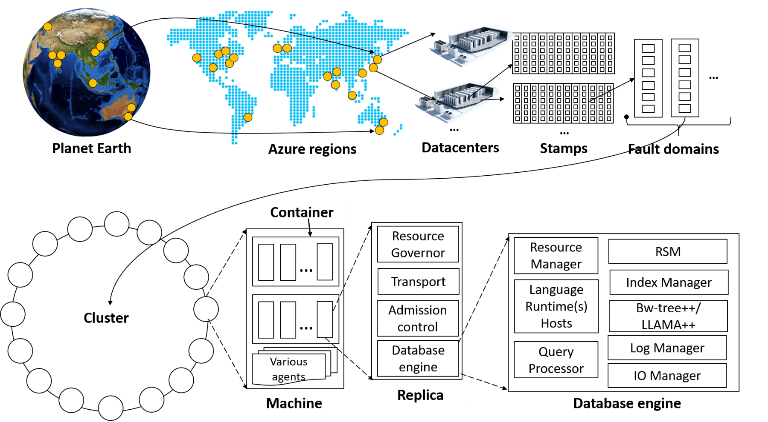
System topology (behind the scenes)
Notes:
The Cosmos DB service is deployed worldwide across all Azure regions including the sovereign and government clouds. We deploy and manage the Cosmos DB service on stamps of machines, each with dedicated local SSDs. The Cosmos DB service is layered on top of Azure Service Fabric, which is a foundational distributed systems infrastructure of Azure. Cosmos DB uses Service Fabric for naming, routing, cluster and container management, coordination of rolling upgrades, failure detection, leader election (within a resource partition) and load balancing capabilities. Cosmos DB is deployed across one or more Service Fabric clusters, each potentially running multiple generations of hardware and of varying number of machines (currently, between 60-800 machines).
Machines within a cluster typically are spread across 10-20 fault domains. The resource partitions is a logical concept. Physically, a resource partition is implemented in terms of a group of replicas, called replica-sets. Each machine hosts replicas corresponding to various resource partitions within a fixed set of processes. Replicas corresponding to the resource partitions are placed and load balanced across these machines. Each replica hosts an instance of Cosmos DB’s schema-agnostic database engine, which manages the resources as well as the associated indexes. The Cosmos DB database engine, in-turn, consists of components including implementation of several coordination primitives, the JavaScript language runtime, the query processor, the storage and indexing subsystems responsible for transactional storage and indexing of data, respectively. To provide durability and high availability, the database engine persists its index on SSDs and replicates it among the database engine instances within the replica-set(s) respectively. While the index is always persisted on local SSDs, the log is persisted either locally, on another machine within the cluster, or remotely across cluster or a datacenter within a region. The proximity of the index and log is configurable based on the price and latency SLA. The ability to dynamically configure the proximity between the database engine (compute) and log (storage) at the granularity of replicas of a resource partition is crucial for allowing tenants to dynamically select various service tiers.

Slide 58
Request Units

Slide 59
% CPU
Request Units
Request Units (RU) is a rate-based currency
Abstracts physical resources for performing requests
Key to multi-tenancy, SLAs, and COGS efficiency
Foreground and background activities
% Memory
% IOPS
Notes:
Azure Cosmos DB is designed to allow customers to elastically scale throughput based on the application traffic patterns across different regions to support fluctuating workloads varying both by geography and time. Operating hundreds of thousands of globally distributed and diverse workloads cost-effectively requires fine-grained multi-tenancy, where hundreds of customers share the same machine and yet thousands share the same cluster. To provide performance isolation to each customer while operating cost-effectively, we’ve engineered the entire system from the ground up with resource governance in mind. As a resource governed system, Azure Cosmos DB is a massively distributed queuing system with cascaded stages of components, each carefully calibrated to deliver predictable throughput while operating within the allotted budget of system resources. In order to optimally utilize the system resources (CPU, memory, disk, and network) available within a given cluster, every machine in the cluster is capable of dynamically hosting from 10s to 100s of customers. Rate-limiting and back-pressure are plumbed across the entire stack from the admission control to all I/O paths. Our database engine is designed to exploit fine-grained concurrency and to deliver high throughput while operating within frugal amounts of system resources.

Slide 60
GET
Request Units
Normalized across various access methods
1 RU = 1 read of 1 KB document
Each request consumes fixed RUs
Applies to reads, writes, queries, and stored procedure execution
POST
PUT
Query
…
Notes:
The number of database operations issued within a unit of time (i.e., throughput) is the fundamental unit of reservation and consumption of system resources. Customers can perform wide range of database operations against their data. Depending on the operation type and the size of (the request and response) payload the operation may consume different amounts of system resources. In order to provide a normalized model for accounting the resources consumed by a request, budget system resources corresponding to the throughput a given resource partition needs to deliver, and charge the customers for throughput across various database operations consistently and in a hardware agnostic manner, we have defined an abstract rate-based currency for throughput called Request Unit or RU, which is available in two denominations based on the time granularity - request units/sec (RU/s) and request units per minute (RU/m).

Slide 61
Request Units
Provisioned in terms of RU/sec
Rate limiting based on amount of throughput provisioned
Can be increased or decreased instantaneously
Metered Hourly
Background processes like TTL expiration, index transformations scheduled when quiescent
Rate limit
Max RU/sec
No throttling
Incoming Requests
Min RU/sec
Replica
Quiescent
Notes:
Customers can elastically scale throughput of a container by programmatically provisioning RU/s (and/or RU/m) on a container. Internally, the system manages resource partitions to deliver the throughput on a given container. Elastically scaling throughput using horizontally partitioning of resources requires that each resource partition is capable of delivering the portion of the overall throughput for a given budget of system resources.
As part of the admission control, each resource partition employs adaptive rate limiting. If the resource partition receives more requests within a second than it was calibrated against, the client will receive “request rate too large” with a back-off interval after which the client can retry. Within each second, a resource partition performs (rate limited) background chores (e.g., background GC of the log structured database engine, taking periodic snapshot backups, deleting expired items etc.) within the spare capacity of RUs (if any). Once a request is admitted, we account for the RUs consumed by each micro-operation (e.g., analyzing an item, reading/writing a page, or executing a query operator).

Slide 62
Pricing Example
Storage Cost
Avg Record Size (KB) | 1
Number of Records | 100,000

Slide 63
Pricing Example
Storage Cost
Avg Record Size (KB) | 1
Number of Records | 100,000
Total Storage (GB) | 100
Monthly Cost per GB | $0.25

Slide 64
Pricing Example
Storage Cost
Avg Record Size (KB) | 1
Number of Records | 100,000
Total Storage (GB) | 100
Monthly Cost per GB | $0.25
Expected Monthly Cost for Storage | $25.00

Slide 65
Pricing Example
Storage Cost
Avg Record Size (KB) | 1
Number of Records | 100,000
Total Storage (GB) | 100
Monthly Cost per GB | $0.25
Expected Monthly Cost for Storage | $25.00
Throughput Cost
Operation Type | Number of Requests per Second | Avg RU's per Request | RU's Needed
Create | 100 | 5 | 500
Read | 400 | 1 | 400

Slide 66
Pricing Example
Storage Cost
Avg Record Size (KB) | 1
Number of Records | 100,000
Total Storage (GB) | 100
Monthly Cost per GB | $0.25
Expected Monthly Cost for Storage | $25.00
Throughput Cost
Operation Type | Number of Requests per Second | Avg RU's per Request | RU's Needed
Create | 100 | 5 | 500
Read | 400 | 1 | 400
Total RU/sec | 900
Monthly Cost per 100 RU/sec | $6.00

Slide 67
Pricing Example
Storage Cost
Avg Record Size (KB) | 1
Number of Records | 100,000
Total Storage (GB) | 100
Monthly Cost per GB | $0.25
Expected Monthly Cost for Storage | $25.00
Throughput Cost
Operation Type | Number of Requests per Second | Avg RU's per Request | RU's Needed
Create | 100 | 5 | 500
Read | 400 | 1 | 400
Total RU/sec | 900
Monthly Cost per 100 RU/sec | $6.00
Expected Monthly Cost for Throughput | $54.00

Slide 68
Pricing Example
Storage Cost
Avg Record Size (KB) | 1
Number of Records | 100,000
Total Storage (GB) | 100
Monthly Cost per GB | $0.25
Expected Monthly Cost for Storage | $25.00
Throughput Cost
Operation Type | Number of Requests per Second | Avg RU's per Request | RU's Needed
Create | 100 | 5 | 500
Read | 400 | 1 | 400
Total RU/sec | 900
Monthly Cost per 100 RU/sec | $6.00
Expected Monthly Cost for Throughput | $54.00
Total Monthly Cost
[Total Monthly Cost] = [Monthly Cost for Storage] + [Monthly Cost for Throughput]
= $25 + $54
= $79 per month

Slide 69
Partitioning

Slide 70
Cosmos DB Container (e.g. Collection)

Slide 71
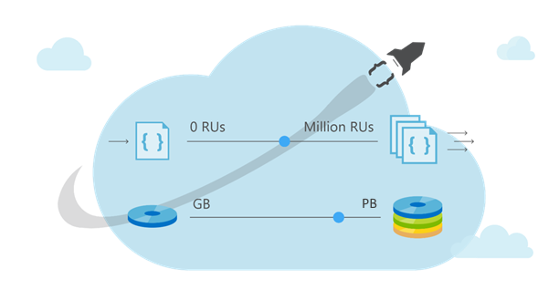
Cosmos DB Container (e.g. Collection)

Slide 72
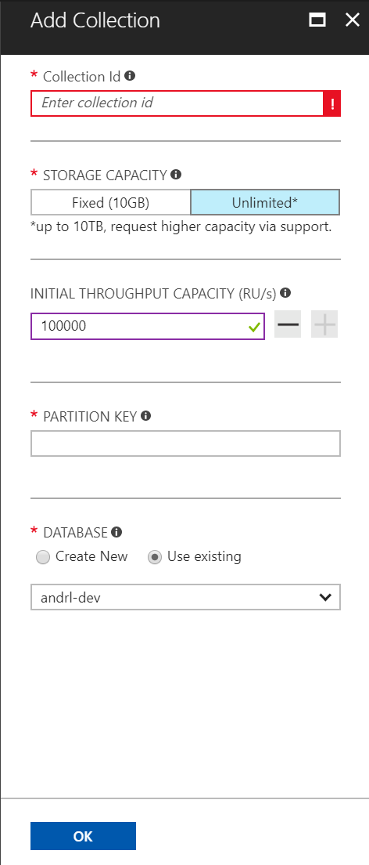
Cosmos DB Container (e.g. Collection)
Partitioning Scheme: top-most design decision in Cosmos DB

Slide 73
Cosmos DB Container (e.g. Collection)
Partition Key: User Id

Slide 74
Cosmos DB Container (e.g. Collection)
Partition Key: User Id
Logical Partitioning Abstraction
hash(User Id)
Behind the Scenes:
Physical Partition Sets
Psuedo-random distribution of data over
range of possible hashed values

Slide 75
Behind the Scenes:
Physical Partition Sets
hash(User Id)
Andrew
Dharma
Shireesh
Karthik
Rimma
Mike
Bob
….
Alice
Carol
…
…
Partition 1
Partition 2
Partition n
Frugal # of Partitions based on actual storage and throughput needs
(yielding scalability with low total cost of ownership)

Slide 76
Behind the Scenes:
Physical Partition Sets
hash(User Id)
Andrew
Dharma
Shireesh
Karthik
Rimma
Mike
Bob
….
Alice
Carol
…
…
Partition 1
Partition 2
Partition n
What happens when partitions need to grow?

Slide 77
Behind the Scenes:
Physical Partition Sets
hash(User Id)
Partition Ranges can be dynamically sub-divided
To seamlessly grow database as the application grows
While sedulously maintaining high availability
Dharma
Dharma
Rimma
Shireesh
Karthik
Rimma
+
Shireesh
Karthik
Alice
Carol
…
…
…
Partition X
Partition X1
Partition X2

Slide 78
Behind the Scenes:
Physical Partition Sets
hash(User Id)
Partition Ranges can be dynamically sub-divided
To seamlessly grow database as the application grows
While sedulously maintaining high availability
Best of All:
Partition management is completely taken care of by the system
You don’t have to lift a finger… the database takes care of you.
Dharma
Dharma
Rimma
Shireesh
Karthik
Rimma
+
Shireesh
Karthik
Alice
Carol
…
…
…
Partition X
Partition X1
Partition X2

Slide 79
Cosmos DB Container (e.g. Collection)
Best Practices: Design Goals for Choosing a Good Partition Key
Distribute the overall request + storage volume
Avoid “hot” partition keys
Partition Key is scope for [efficient] queries and transactions
Queries can be intelligently routed via partition key
Omitting partition key on query requires fan-out

Slide 80
Cosmos DB Container (e.g. Collection)
Best Practices: Design Goals for Choosing a Good Partition Key
Distribute the overall request + storage volume
Avoid “hot” partition keys
Partition Key is scope for [efficient] queries and transactions
Queries can be intelligently routed via partition key
Omitting partition key on query requires fan-out
Steps for Success
Ballpark scale needs (size/throughput)
Understand the workload
# of reads/sec vs writes per sec
Use 80/20 rule to help optimize bulk of workload
For reads – understand top X queries (look for common filters)
For writes – understand transactional needs understand ratio of inserts vs updates

Slide 81
Cosmos DB Container (e.g. Collection)
Best Practices: Design Goals for Choosing a Good Partition Key
Distribute the overall request + storage volume
Avoid “hot” partition keys
Partition Key is scope for [efficient] queries and transactions
Queries can be intelligently routed via partition key
Omitting partition key on query requires fan-out
Steps for Success
Ballpark scale needs (size/throughput)
Understand the workload
# of reads/sec vs writes per sec
Use 80/20 rule to help optimize bulk of workload
For reads – understand top X queries (look for common filters)
For writes – understand transactional needs understand ratio of inserts vs updates
General Tips
Don’t be afraid of having too many partition keys
Partitions keys are logical
More partition keys => more scalability

Slide 82
Object Model Design

Slide 83
A few notes about containers
Containers do NOT enforce schema
There are benefits to co-locate multiple types in a container
Annotate records with a "type" property

Slide 84
Co-locating types in the same container
Ability to query across multiple entity types with a single network request.

Slide 85
Ability to query across multiple entity types with a single network request.
For example, we have two types of documents: cat and person.
{
"id": "Andrew",
"type": "Person",
"familyId": "Liu",
"worksOn": "Azure Cosmos DB"
}
{
"id": "Ralph",
"type": "Cat",
"familyId": "Liu",
"fur": {
"length": "short",
"color": "brown"
}
}

Slide 86
Ability to query across multiple entity types with a single network request.
For example, we have two types of documents: cat and person.
{
"id": "Andrew",
"type": "Person",
"familyId": "Liu",
"worksOn": "Azure Cosmos DB"
}
{
"id": "Ralph",
"type": "Cat",
"familyId": "Liu",
"fur": {
"length": "short",
"color": "brown"
}
}
We can query both types of documents without needing a JOIN simply by running a query without a filter on type:
SELECT * FROM c WHERE c.familyId = "Liu"

Slide 87
Ability to query across multiple entity types with a single network request.
For example, we have two types of documents: cat and person.
{
"id": "Andrew",
"type": "Person",
"familyId": "Liu",
"worksOn": "Azure Cosmos DB"
}
{
"id": "Ralph",
"type": "Cat",
"familyId": "Liu",
"fur": {
"length": "short",
"color": "brown"
}
}
If we wanted to filter on type = “Person”, we can simply add a filter on type to our query:
SELECT * FROM c WHERE c.familyId = "Liu" AND c.type = "Person"

Slide 88
Co-locating types in the same container
Ability to query across multiple entity types with a single network request.
Ability to perform transactions across multiple types
Cost: reduce physical partition footprint*
Notes:
*point-in-time (current date is 12/7/2017); we have roadmap items to make collection cost friendlier

Slide 89
Global Distribution

Slide 90
Why Global Distribution
High Availability
Automatic and Manuel Failover
Multi-homing API removes need for app redeployment
Low Latency (anywhere in the world)
Packets cannot move fast than the speed of light
Sending a packet across the world under ideal network conditions takes 100’s of milliseconds
You can cheat the speed of light – using data locality
CDN’s solved this for static content
Azure Cosmos DB solves this for dynamic content
Notes:
Cosmos DB is a Foundational (Ring 0) Azure service
Available in all Azure regions by default, including sovereign/government clouds
Transparent and automatic multi-region replication
Associate any number of regions with your database account, at any time
Policy based geo-fencing
Multi-homing APIs
All endpoints are logical, by default
Apps don’t need to be redeployed during regional failover
Apps can also access physical endpoints if needed
Support for both manual and automatic failover
Designed for high availability
Allows for dynamically setting priorities to regions
Simulate regional disasters via API
Test the end-to-end availability for the entire app (beyond just the database)

Slide 91
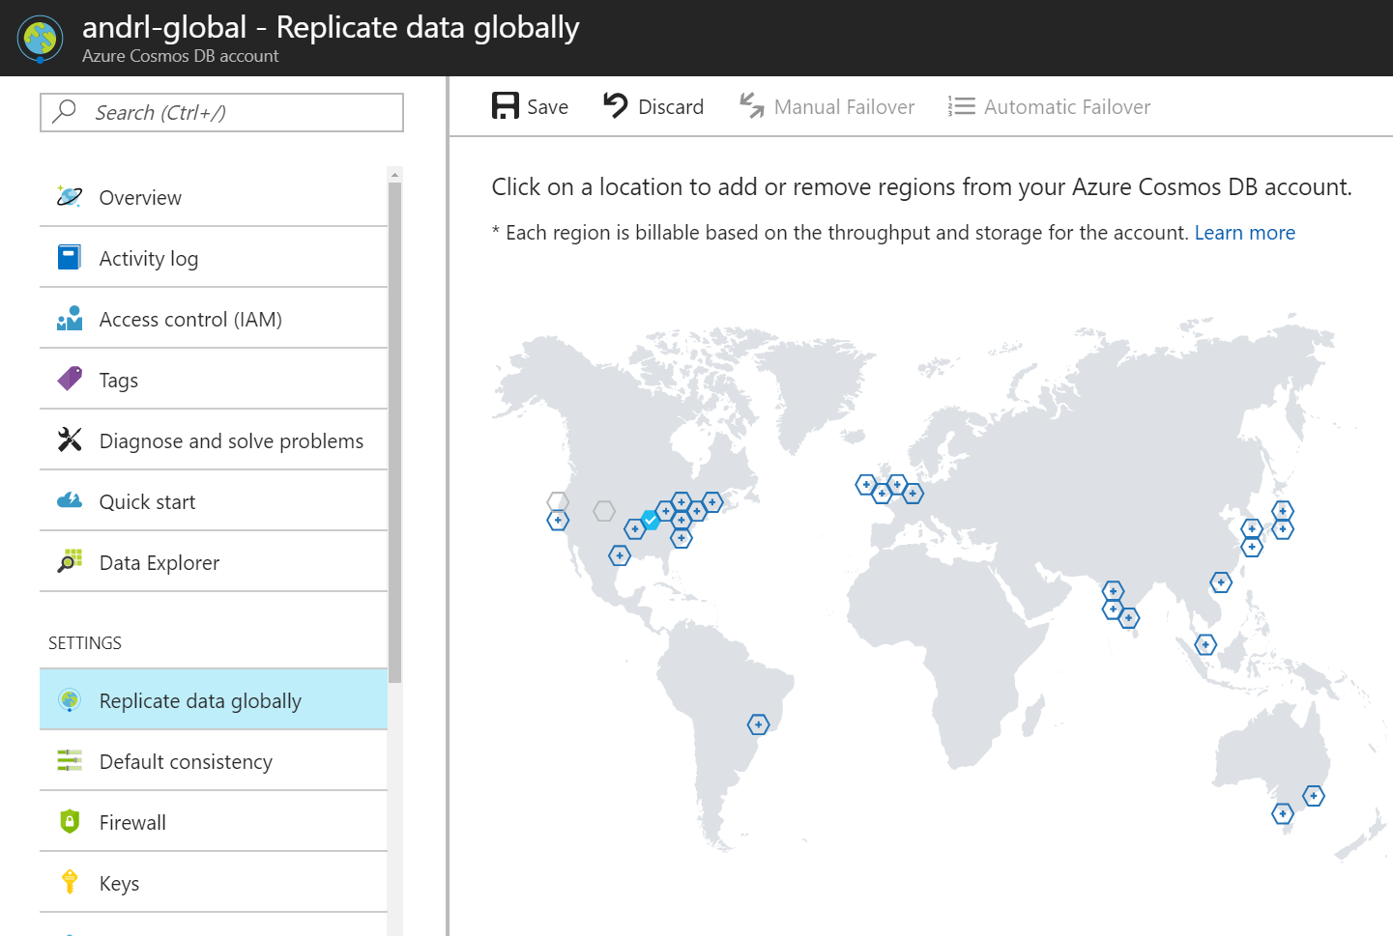

Slide 93
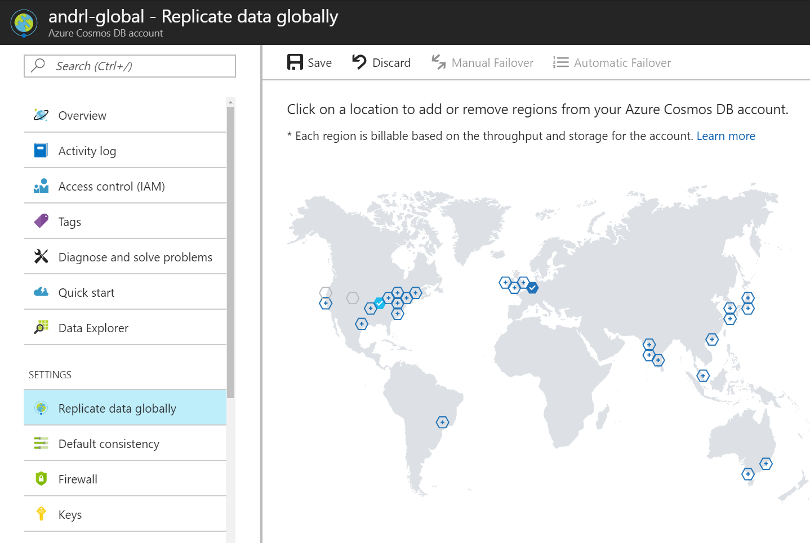

Slide 94


Slide 96
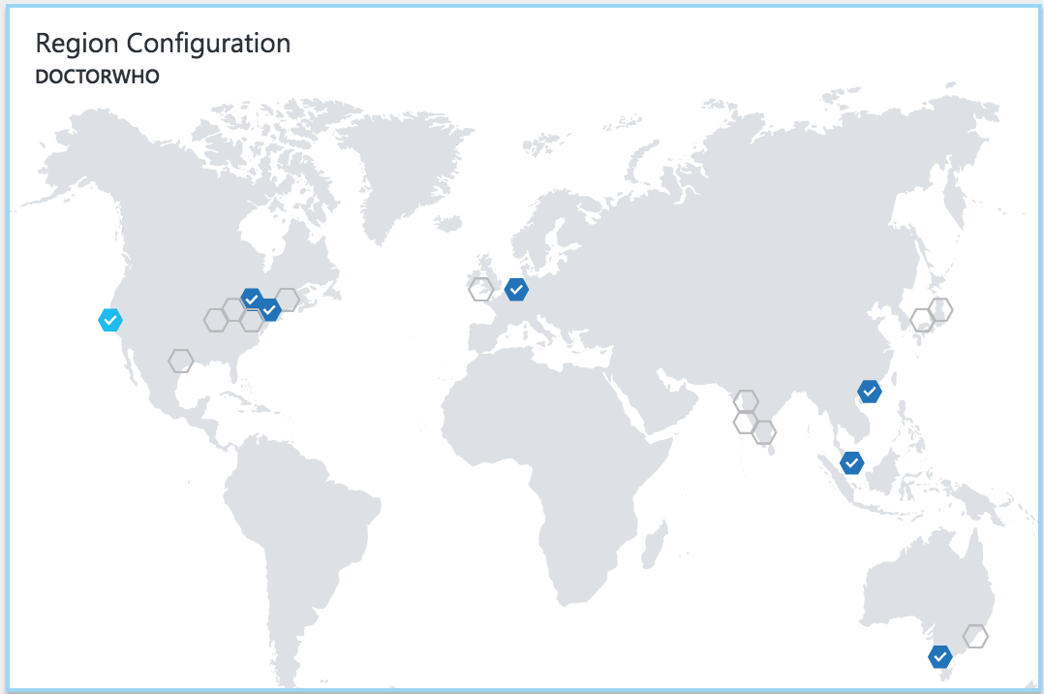


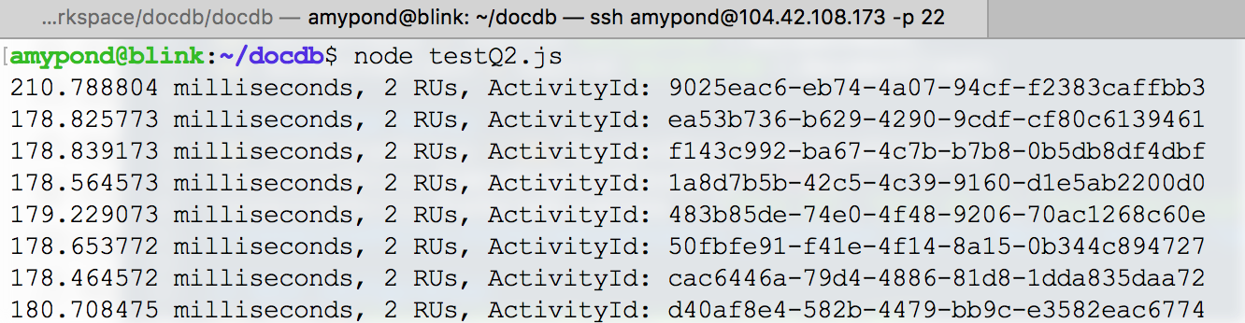

Slide 97
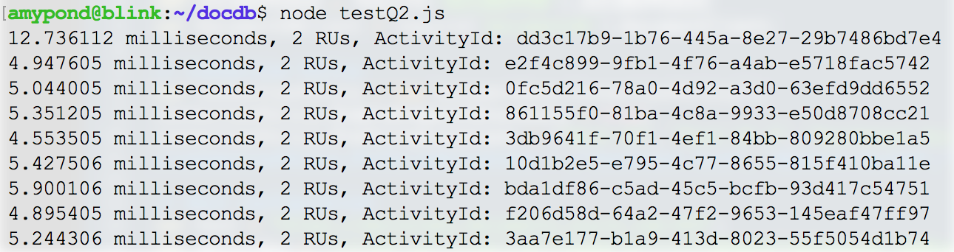

Slide 98
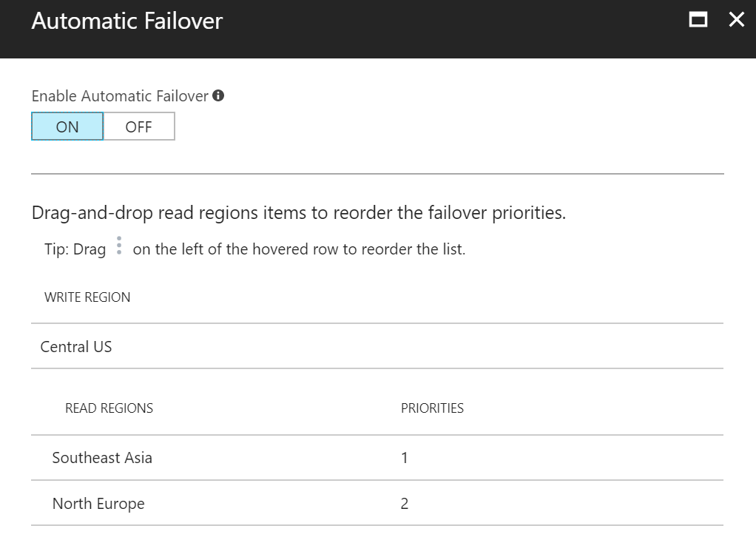

Slide 100
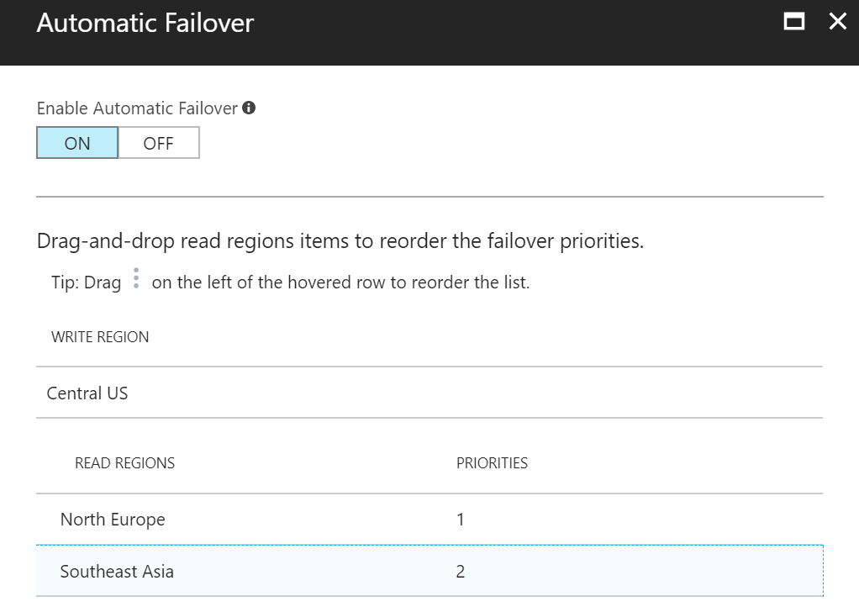

Slide 101
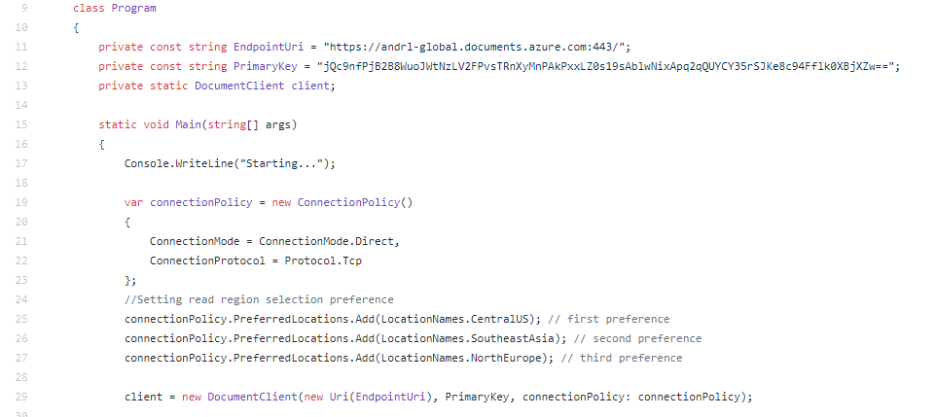

Slide 102
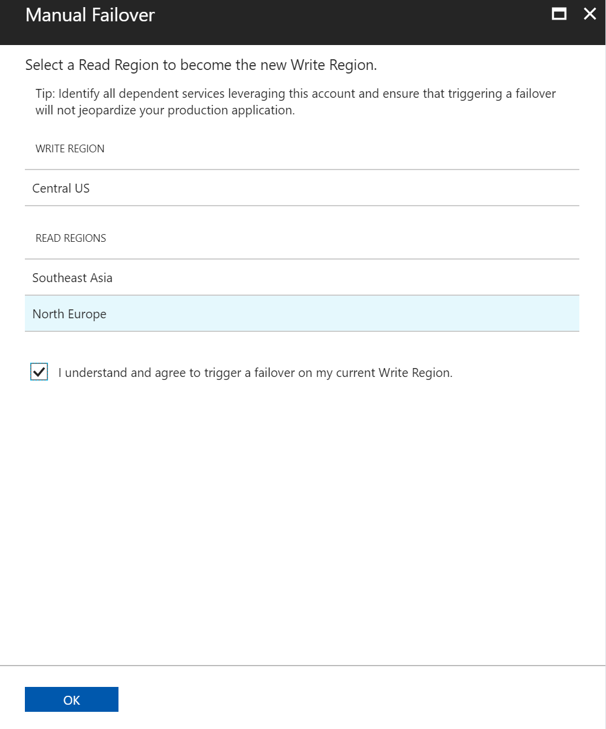

Slide 103
Consistency

Slide 104
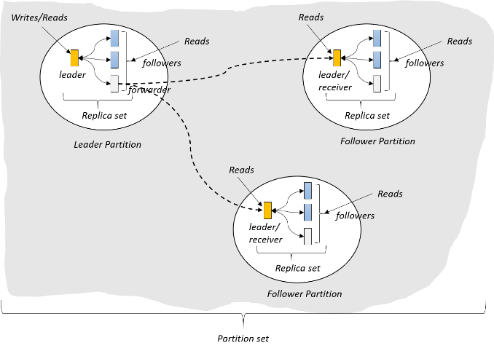
(West US)
(East US)
(North Europe)

Slide 105
Value = 5
Value = 5
Value = 5

Slide 106
Value = 5 6
Update 5 => 6
Value = 5
Value = 5

Slide 107
Value = 5 6
Update 5 => 6
Value = 5 6
Value = 5
What happens when a network partition is introduced?

Slide 108
Value = 5 6
Update 5 => 6
Value = 5 6
Value = 5
What happens when a network partition is introduced?
Reader: What is the value?
Should it see 5? (prioritize availability)
Or does the system go offline until network is restored? (prioritize consistency)

Slide 109
Brewer’s CAP Theorem: impossible for distributed data store to simultaneously provide more than 2 out of the following 3 guarantees:
Consistency, Availability, Partition Tolerance

Slide 110
Latency: packet of information can travel as fast as speed of light.
Replication between distant geographic regions can take 100’s of milliseconds
Value = 5 6
Update 5 => 6
Value = 5 6
Value = 5

Slide 111
Reader A: What is the value?
Value = 5 6
Update 5 => 6
Value = 5 6
Value = 5
Reader B: What is the value?

Slide 112
Reader A: What is the value?
Value = 5 6
Update 5 => 6
Value = 5 6
Value = 5
Reader B: What is the value?
Should it see 5 immediately? (prioritize latency)
Does it see the same result as reader A? (quorum impacts throughput)
Or does it sit and wait for 5 => 6 propagate? (prioritize consistency)

Slide 113
PACELC Theorem: In the case of network partitioning (P) in a distributed computer system, one has to choose between availability (A) and consistency (C) (as per the CAP theorem), but else (E), even when the system is running normally in the absence of partitions, one has to choose between latency (L) and consistency (C).

Slide 114

Programmable Data Consistency
Choice for most distributed apps
Strong consistency High latency
Eventual consistency, Low latency

Slide 115
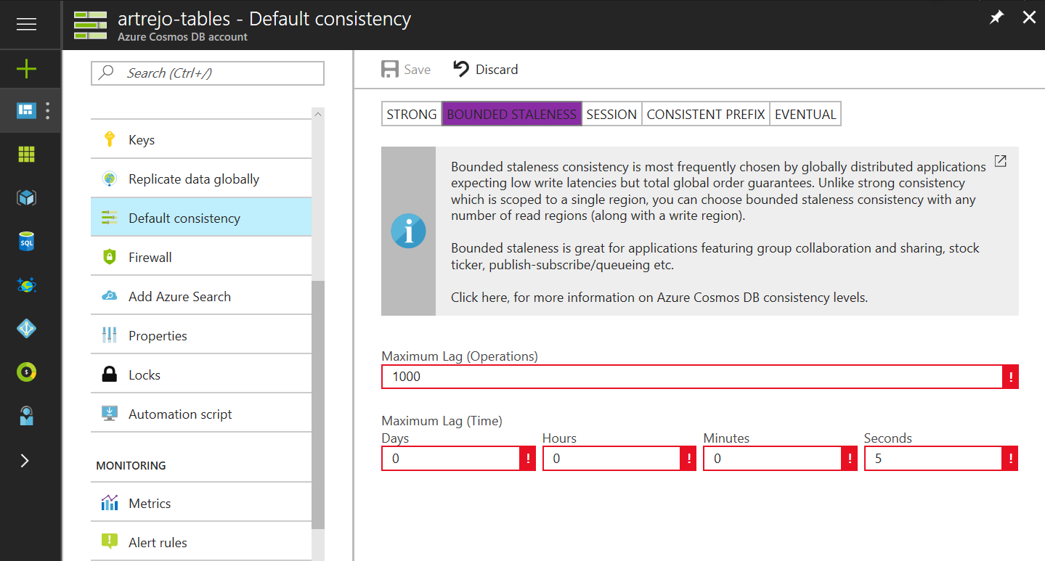

Well-defined consistency models
Intuitive programming model
5 Well-defined, consistency models
Overridable on a per-request basis
Clear tradeoffs
Latency
Availability
Throughput

Slide 116
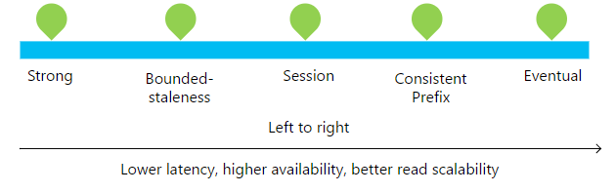

Slide 117
Consistency Level | Guarantees
Strong | Linearizability (once operation is complete, it will be visible to all)
Bounded Staleness | Consistent Prefix. Reads lag behind writes by at most k prefixes or t interval Similar properties to strong consistency (except within staleness window), while preserving 99.99% availability and low latency.
Session | Consistent Prefix. Within a session: monotonic reads, monotonic writes, read-your-writes, write-follows-reads Predictable consistency for a session, high read throughput + low latency
Consistent Prefix | Reads will never see out of order writes (no gaps).
Eventual | Potential for out of order reads. Lowest cost for reads of all consistency levels.

Slide 118
Bounded-Staleness: Bounds are set server-side via the Azure Portal

Slide 119
Session Consistency: Session is controlled using a “session token”.
Session tokens are automatically cached by the Client SDK
Can be pulled out and used to override other requests (to preserve session between multiple clients)
string sessionToken;
using (DocumentClient client = new DocumentClient(new Uri(""), ""))
{
ResourceResponse<Document> response = client.CreateDocumentAsync(
collectionLink,
new { id = "an id", value = "some value" }
).Result;
sessionToken = response.SessionToken;
}
using (DocumentClient client = new DocumentClient(new Uri(""), ""))
{
ResourceResponse<Document> read = client.ReadDocumentAsync(
documentLink,
new RequestOptions { SessionToken = sessionToken }
).Result;
}

Slide 120
Consistency can be relaxed on a per-request basis
client.ReadDocumentAsync(
documentLink,
new RequestOptions { ConsistencyLevel = ConsistencyLevel.Eventual }
);

Slide 121
Indexing

Slide 122
Schema-agnostic, automatic indexing
Automatically index every property of every record without having to define schemas and indices upfront.
No need for schema and index management
Works across every data model
Latch free data structure for highly write-optimized database engine
Multiple index types: Hash, range, and geospatial
Schema
Physical index
Notes:
At global scale, schema/index management is hard
Automatic and synchronous indexing of all ingested content - hash, range, geo-spatial, and columnar
No need to define schemas or secondary indices upfront
Resource governed, write optimized database engine with latch free and log structured techniques
Online and in-situ index transformations

Slide 123
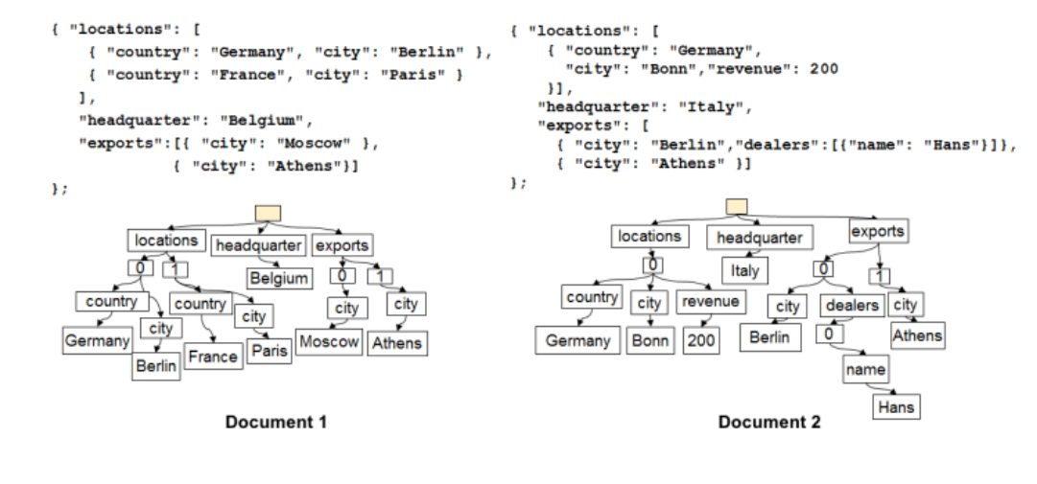

Slide 124
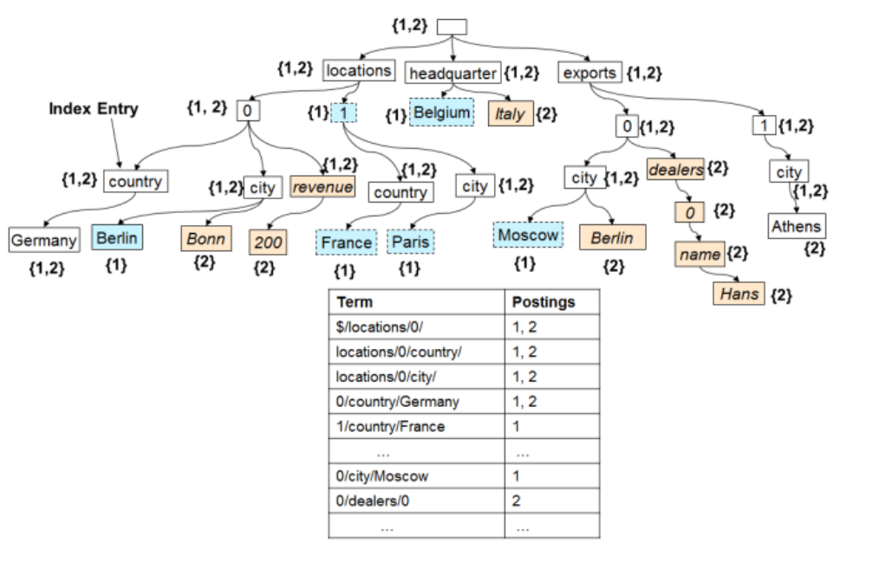

Slide 125
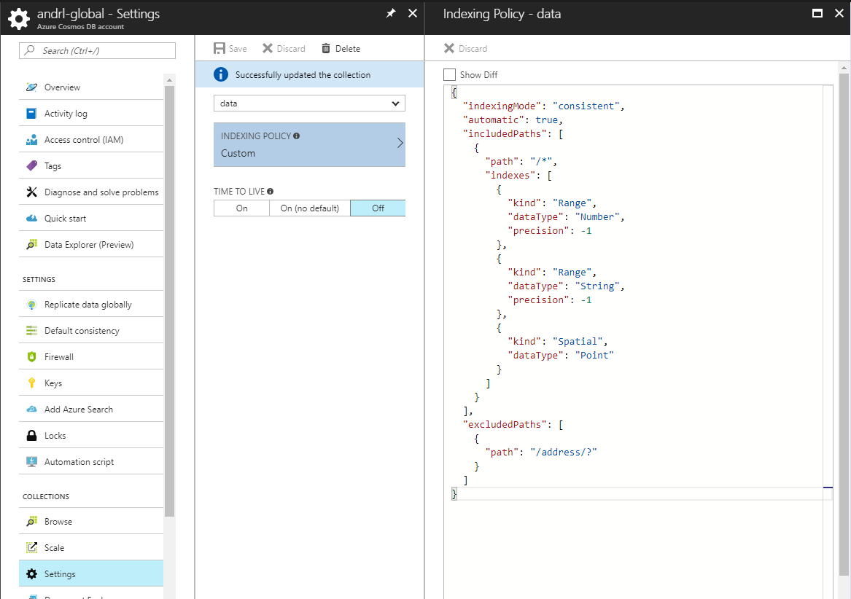

Slide 126
SQL (DocumentDB) API

Slide 127
Query Demo:
https://www.documentdb.com/sql/demo

Slide 128
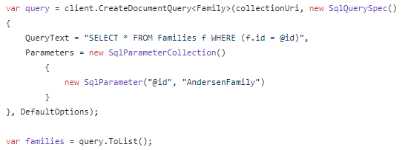
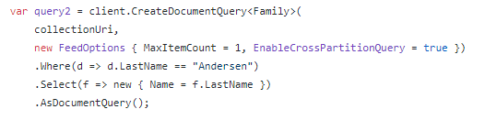
DocumentDB (SQL) API
Example: SQL Parameterization
Example: LINQ

Slide 129
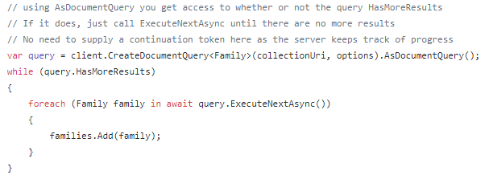
DocumentDB (SQL) API
Query Results are paginated:
ToList() automatically iterates through all pages:

Slide 130
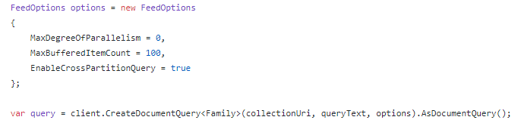
DocumentDB (SQL) API
Cross-Partition Queries

Slide 131
Change Feed

Slide 132
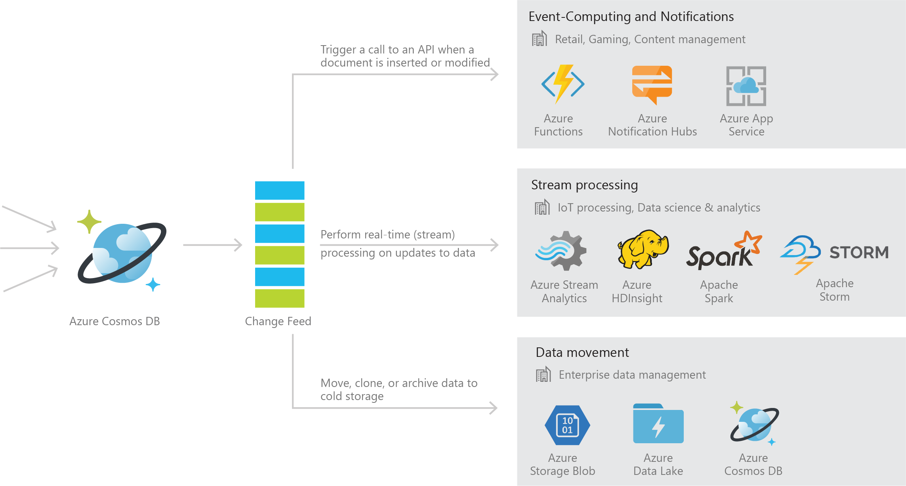
Azure Cosmos DB Change Feed
Persistent log of records within an Azure Cosmos DB container in the order in which they were modified

Slide 133
Common Scenarios

Slide 134

Event Sourcing for Microservices
Trigger Action From Change Feed
Persistent Event Store
Microservice
#1
Microservice #2
New Event
…
Microservice #N

Slide 135
Materializing Views
Application
Cosmos DB
Materialized View
Subscription | User | Create Date | …
123abc | Ben6 | 6/17/17
456efg | Ben6 | 3/14/17
789hij | Jen4 | 8/1/16
012klm | Joe3 | 3/4/17
User | Total Subscriptions
Ben6 | 2
Jen4 | 1
Joe3 | 1

Slide 136
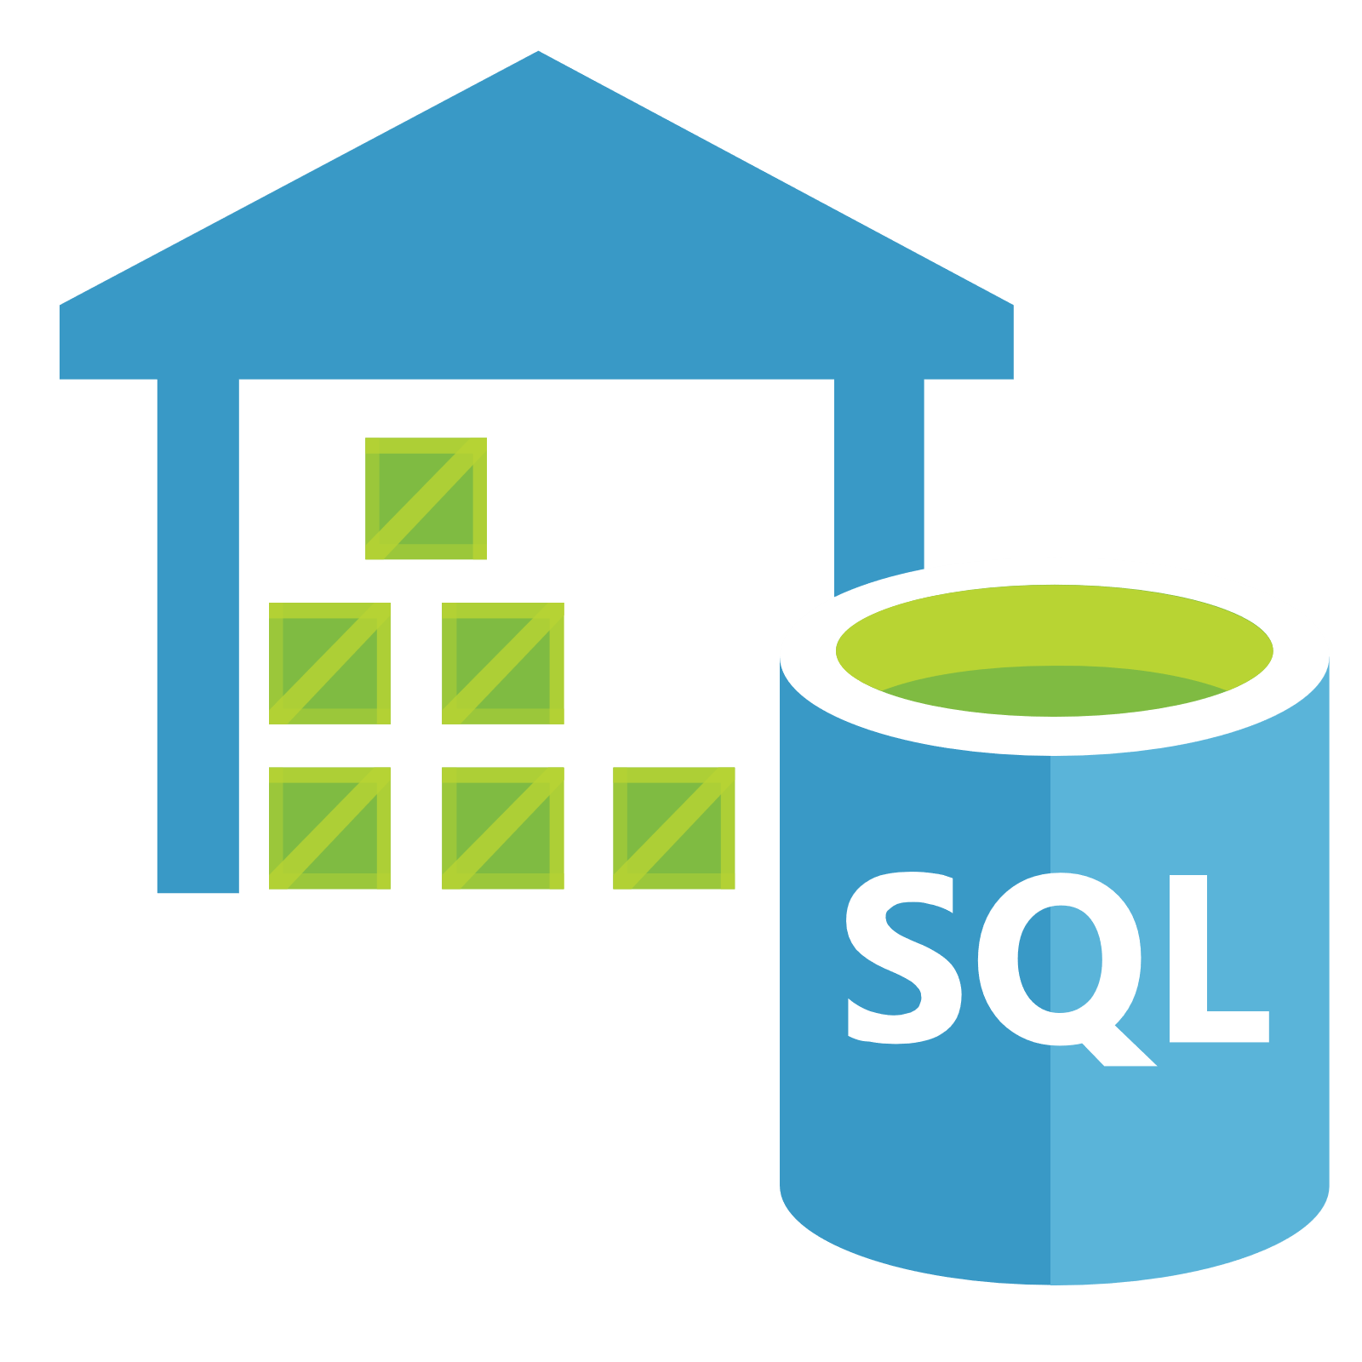

Replicating Data
Secondary Datastore (e.g. archive)
Replicate Records
CRUD Data

Slide 137
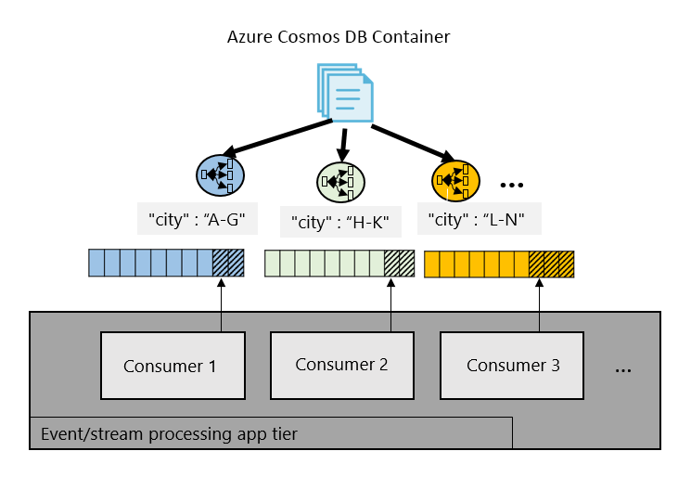
Working with Change Feed

Slide 138
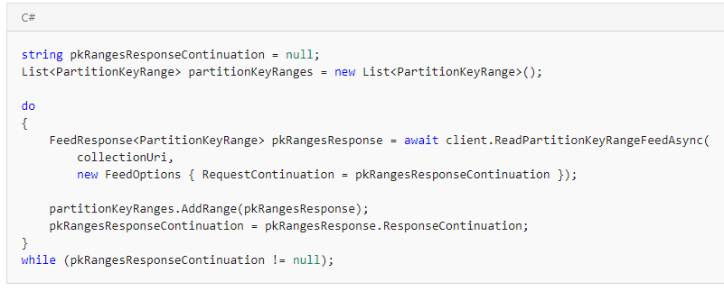
Working with Change Feed
Step 1: Retrieve a list of the partition key ranges

Slide 139
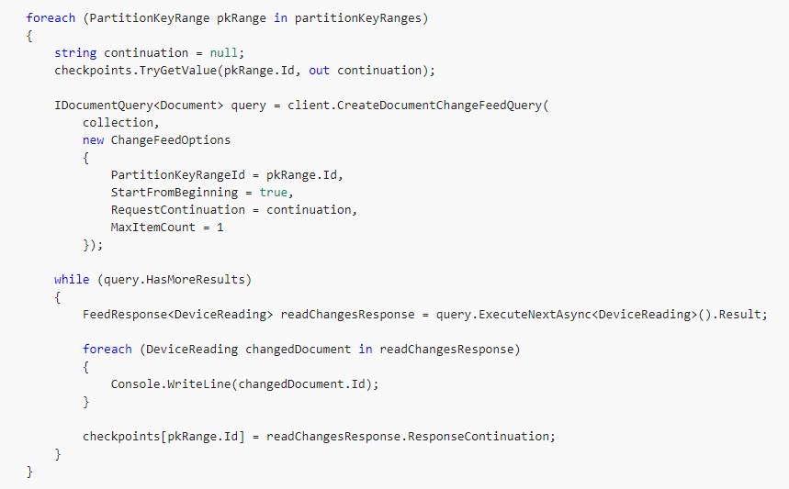
Working with Change Feed
Step 2: Consume the Change Feed on each PartitionKeyRange

Slide 140
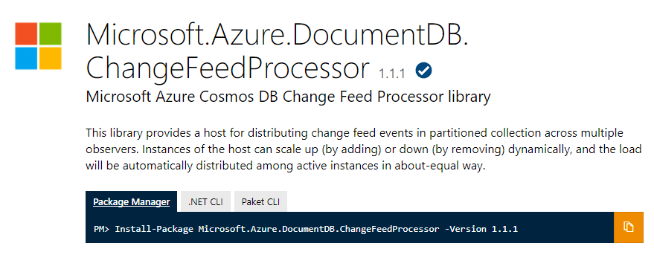
Change Feed Processor Library

Slide 141
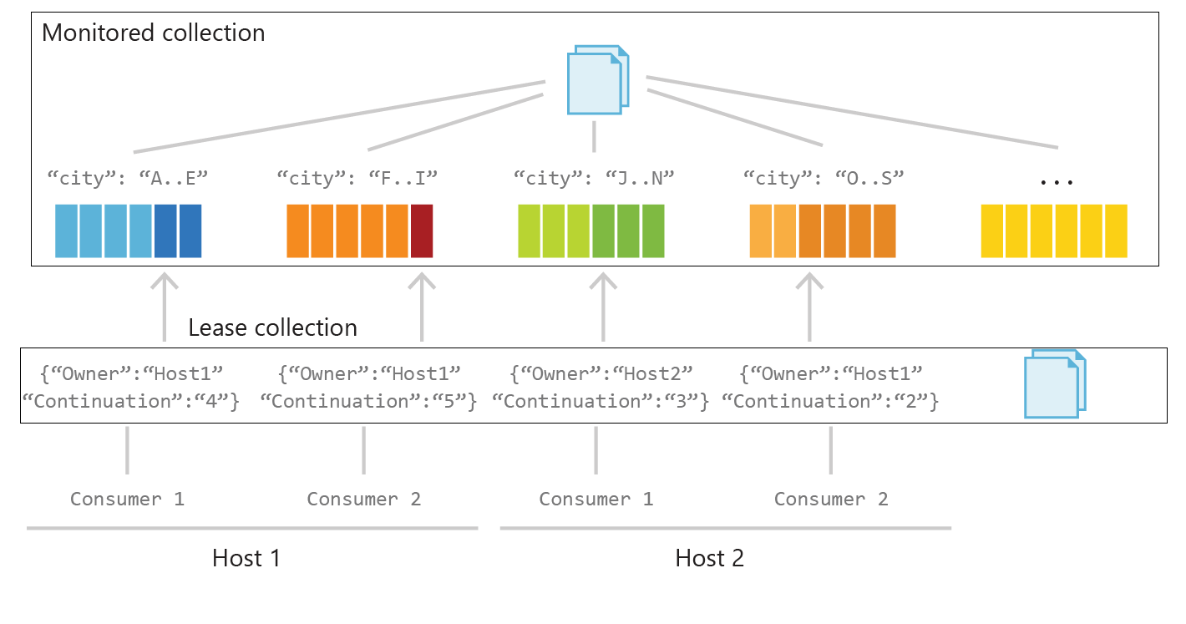
Behind the Scenes

Slide 142
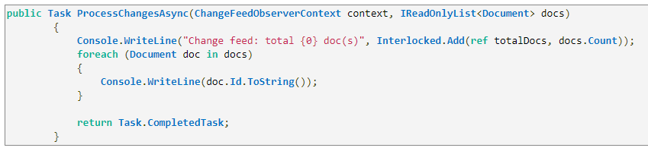
Working with Change Feed Processor Library
Step 1: Implement ProcessChangesAsync() on IChangeFeedObserver

Slide 143
Working with Change Feed Processor Library
Step 2: Register the IChangeFeedObserver with to a ChangeFeedEventHost

Slide 144


Thank you and Q&A
Follow @AzureCosmosDB
Use #CosmosDB
cosmosdb.com
#azure-cosmosdb

